Slide 1

Your eyes provide a window to your health
Value Standard Exam and Eyewear
YOUR BLUE CROSS VISION PLAN INCLUDES BENEFITS TO HELP KEEP YOU AND YOUR WALLET HEALTHY
  Eye exams 100 percent coverage for routine eye exam after $25 copay
  Eyeglasses and contact lenses discounts
  Breakage warranty, scratch-resistant coating and blue light lens coverage
1
2
  OUT OF
  ADULTS HAS AT LEAST ONE
  CHRONIC HEALTH ISSUE
  that an eye exam can help detect²

Slide 2


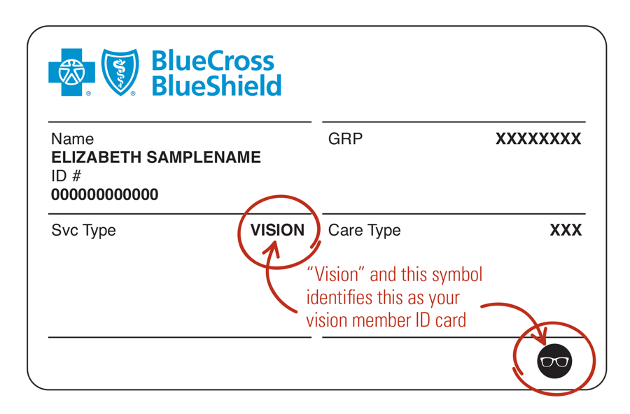





Blue cross vision: a clear choice
DAVIS VISION NATIONAL NETWORK
  Access to many leading retail locations like America’s Best,
  Target Optical, Pearle Vision and Shopko Optical, as well as
  online providers like 1800Contacts.com, glasses.com, and befitting.com.
EASY ONLINE EXPERIENCE
  Makes it easy for members to use their benefits.
  SIGN IN AND REGISTER WITH VISION ID CARD
4
5
  OUT OF
  SHOP FOR EYEWEAR
  TOP OPTICAL RETAILERS PARTICIPATE
  Including Visionworks, Costco, Walmart and Sam’s Club¹
  SUBMIT ORDER
  EYEWEAR SHIPPED TO THE MEMBER

Slide 3
Vision benefit – Value Standard exam and eyewear – option 1
Eye exam – Includes dilation when recommended by eye care professional | 100% after $10 copay
LENSES AND FRAMES
Lenses – Single vision, lined bifocal, trifocal, lenticular, polycarbonate (dependent children) | 100% after $25 copay
Frame frequency | 1 every 12 months
Davis Vision Exclusive Collection Fashion / Designer / Premier level | 100% no copay / 100% no copay / 100% $25 copay
Non-Davis Vision Exclusive Collection Visionworks stores Participating retailers | No copay; plan pays up to $180 plus 20% discount on remaining costs No copay; plan pays up to $130 plus 20% discount on remaining costs
EYEGLASS ENHANCEMENTS EXAMPLES
UV coating Scratch-resistant coating Blue light filter Polarized lenses Additional enhancements in plan such as progressive lenses, anti-reflective coating and high-index lenses | Member pays $12 Single vision $20 / Multifocus vision $40 Member pays $15 Member pays $75 Refer to benefit material
CONTACT LENSES
Evaluation, fitting and follow-up care for standard lenses | 100% after $25 copay
Collection contact lenses | Disposable up to 4 boxes Non-disposable up to 2 boxes
Non-collection contact lens allowance | Plan pays up to $130 plus 15% of remaining cost
VISION BENEFIT [PLAN NAME]
Notes:
[CUSTOMIZE SLIDE]
The first column above is fine for any plan that utilizes FlexRx or GenRx. For KeyRx/FocusRx the labels should be Tier 1, Tier 2 and Tier 3
[USE THIS SLIDE FOR PRIME THERAPEUTICS ADMINISTRATION ONLY: OTHER PLANS MAY USE A CARVE-OUT PBM]
[USE THIS SLIDE IF:
NO SEPARATE BENEFIT FOR LIFESTYLE DRUGS
PLAN HAS HRA WHERE Rx BENEFITS DO NOT APPLY TO DEDUCTIBLE
SPECIALTY DRUG BENEFIT IS INCLUDED]
NOTE: 90DAYRX RETAIL PICKUP IS 3X COPAY AND 90DAYRX HOME DELIVERY (PRIME MAIL) IS 3X COPAY
Take a minute to look at the benefits of your plan and notice the copay or coinsurance amounts for the different options.
You can pay for prescriptions with funds in your account. If you use all the money in your account, you pay for prescriptions out of pocket until you meet your deductible.
Note that specialty drugs are also covered. You’ll hear more about this benefit later in the presentation.

