Slide 1
2026 Open Enrollment
Arrowhead Economic Opportunity Agency

Slide 2


Our mission
Promote healthier lives.
Our vision
Be a leader in customer-centric products and innovations for oral and overall health, as well as a beacon of community impact.

Slide 3
A snapshot of your coverage
Service Category | Delta Dental PPO™ | Delta Dental Premier® | Out-of-Network
Diagnostic & Preventive (exams/cleanings) | 100% | 100% | 100%
Basic Services (amalgam and anterior composite fillings) | 80% | 80% | 80%
Endodontics (root canals) | 80% | 80% | 80%
Periodontics (treatment relating to gum disease) | 80% | 80% | 80%
Oral Surgery – Surgical & Nonsurgical Extractions All other covered oral surgery | 80% | 80% | 80%
Major Restorative Services (crowns and posterior composite fillings) | 50% | 50% | 50%
Prosthetic Repairs & Adjustments | 50% | 50% | 50%
Prosthetics (bridges and dentures) | 50% | 50% | 50%
Orthodontics (Children ages 8-18) | 50% | 50% | 50%
Deductible Per person/per family (calendar year) No deductible for Diagnostic & Preventive and Orthodontics | $50/$150 | $50/$150 | $50/$150
Annual Maximum (per person) | $2,000 | $2,000 | $2,000
Orthodontic Lifetime Maximum | $1,000 | $1,000 | $1,000

Slide 4
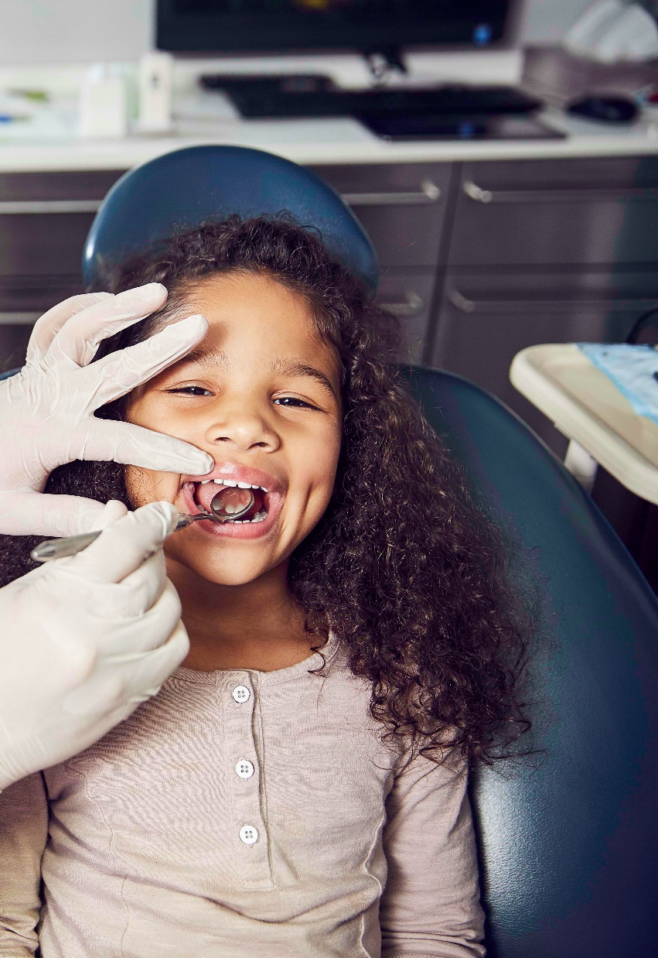
Reasons to visit the dentist
The standard recommendation is to see your dentist at least once per year. This sounds small, but when it comes to your health, the impacts are BIG!
A single appointment with your dentist can:
Improve the health of your teeth & gums with a thorough cleaning.
Reveal oral health issues such as cavities & gum disease.
Provide an opportunity to screen for more serious underlying health conditions.
Receive personal oral health advice and care so you have the best information to keep your mouth healthy.

Slide 5

In-network and Out-of-Network coverage
Perks of seeing an in-network dentist include: (Delta Dental PPO™/Delta Dental Premier®)
Network savings on covered services
No balance billing; Annual benefit dollars go further
Dentists submit claims directly to Delta Dental & Delta Dental sends plan payment directly to the dentist
What happens when you visit an out-of-network dentist?
If the dentist’s fees are higher than Delta Dental’s allowable charge, you may be responsible to pay the difference.
You are responsible for submitting a claim form to Delta Dental, though your dentist may assist you.
Benefit payments go directly to you

Slide 6
Digital member tools

Slide 7
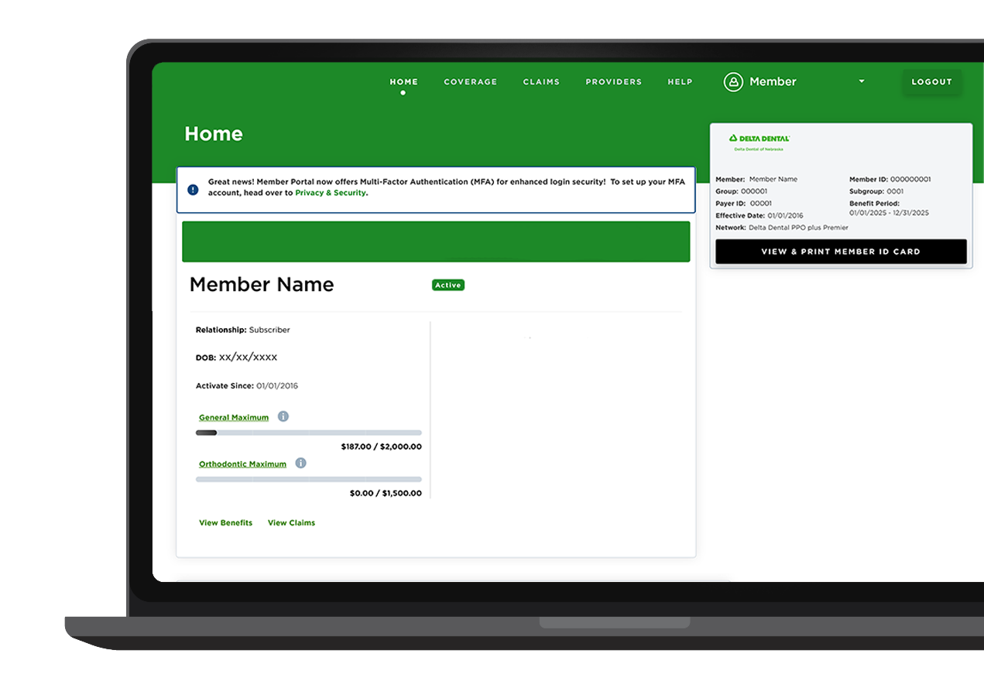
Member Portal DeltaDentalMN.org/members
Features:
View claims history
View coverage/benefits
View ID cards
Find a Dentist tool
Digital Explanation of Benefits – received by email within days of visit

Slide 8
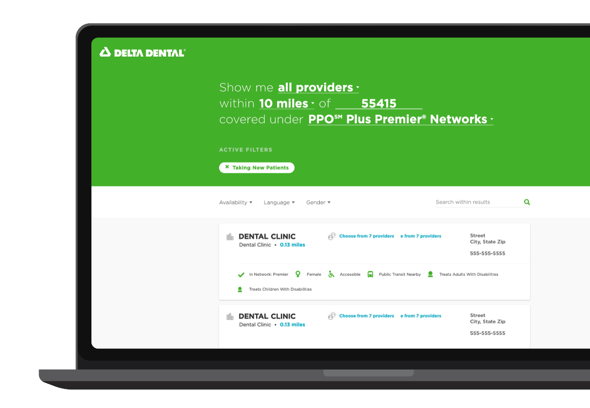
Find a Dentist tool DeltaDentalMN.org/find-a-dentist
Users have the option to search for a new dentist or see if current dentist is in network.
Search by: location, name and network.
In-depth results show providers and clinics, proximity of public transit, accessibility and more.

Slide 9
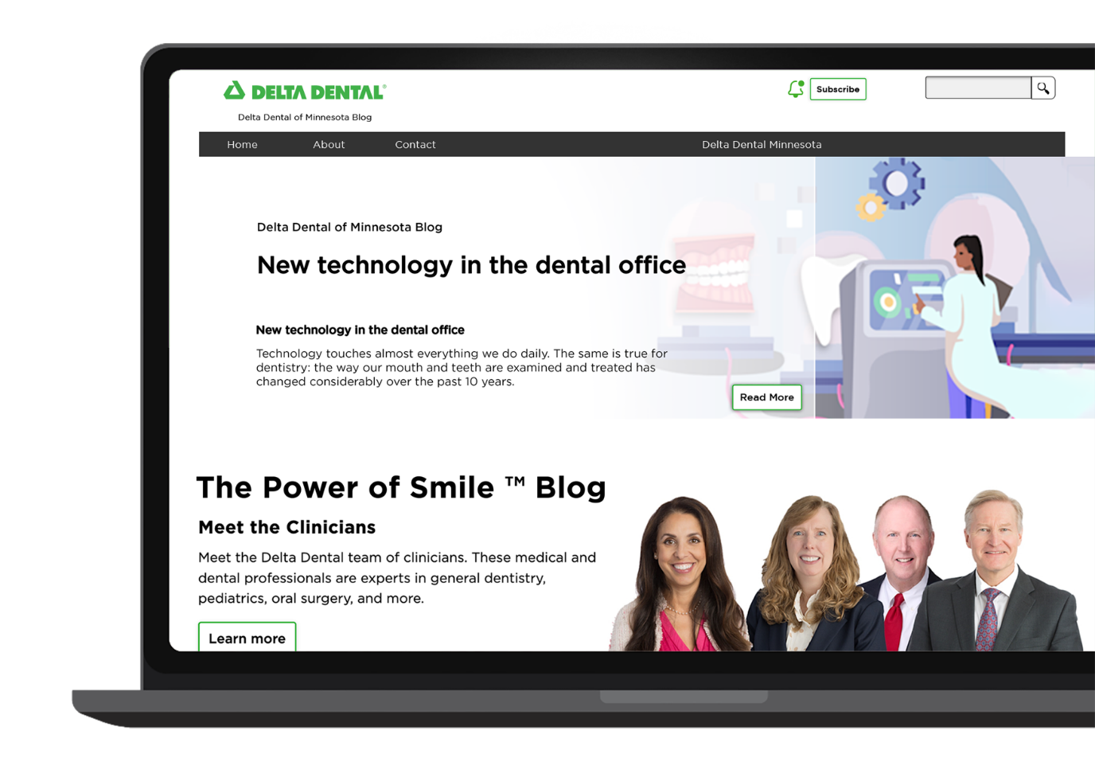
The Power of SmileTM Blog blog.DeltaDentalMN.org
Learn about current topics and trends in dentistry and the importance of oral health as it relates to overall health from our team of experts.

Slide 10
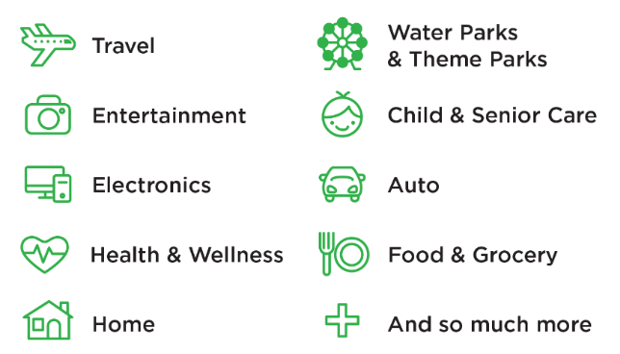
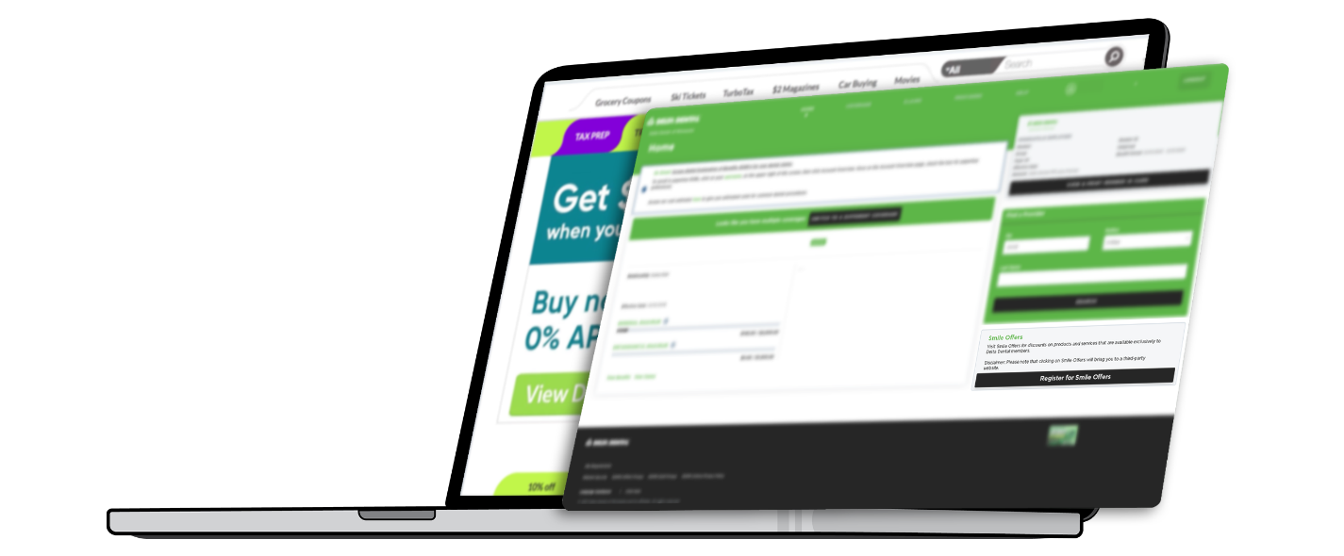
Smile Offers
Exclusive discounts on products and services available to Delta Dental of Minnesota members.
Access your Smile Offers:
Log in to the Member Portal and click Smile Offers.
You will automatically be redirected to a third-party exclusive discount site where you can sign up for special offers.
Start saving!

