Slide 1
Reflectivity by Swivl

Slide 2
Contents:
Reflectivity by Swivl Basics
Using the Reflectivity website (using the laptop only)
Uploading
Editing
Sharing
Sessions Mode

Slide 3
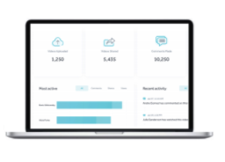
“Reflectivity” by Swivl
Reflectivity by Swivl (website) is accessed by a computer/laptop and has more functionality than the iPad app titled Capture by Swivl. The preferred browers are: Chrome and Firefox.
Reflectivity by Swivl (website) is a web-based service that allows you to host, view, edit, comment and share video that has been uploaded to the Reflectivity by Swivl hosting site.
Reflectivity by Swivl (website) also includes a recording feature that doesn’t require the robot or iPad. You can record from your laptop.
Video captured and stored in Reflectivity by Swivl is securely stored and meets data privacy requirements of FERPA (Family Educational Rights and Privacy Act) and COPPA (Children’s Online Privacy Protection Act).

Slide 4
Reflectivity by Swivl Components
Swivl Robot
Capture iPad App
Reflectivity Website
Rotates to easily track and record the person wearing the primary marker.
Multiple microphones (Markers)
iPad app used to record or stream video. Used in conjunction with the robot. Video can be automatically uploaded to the Reflectivity secure cloud space.
See all of your content! View, edit, share, and collaborate.

Slide 5
Logging in to the Reflectivity by Swivl Website Learn the Landing Page and Dashboard

Slide 6
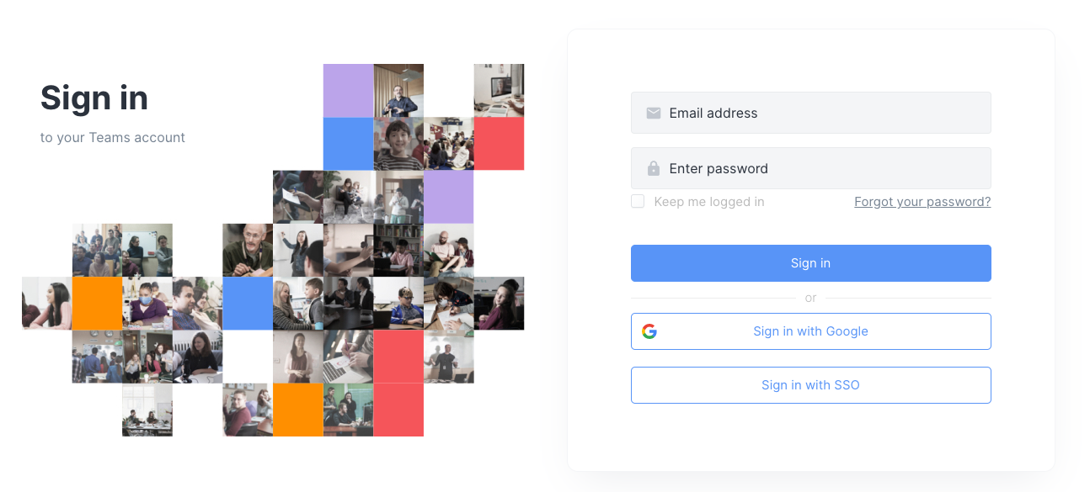
Login to Your Reflectivity Account
On your laptop – log in using cloud.swivl.com/login

Slide 7
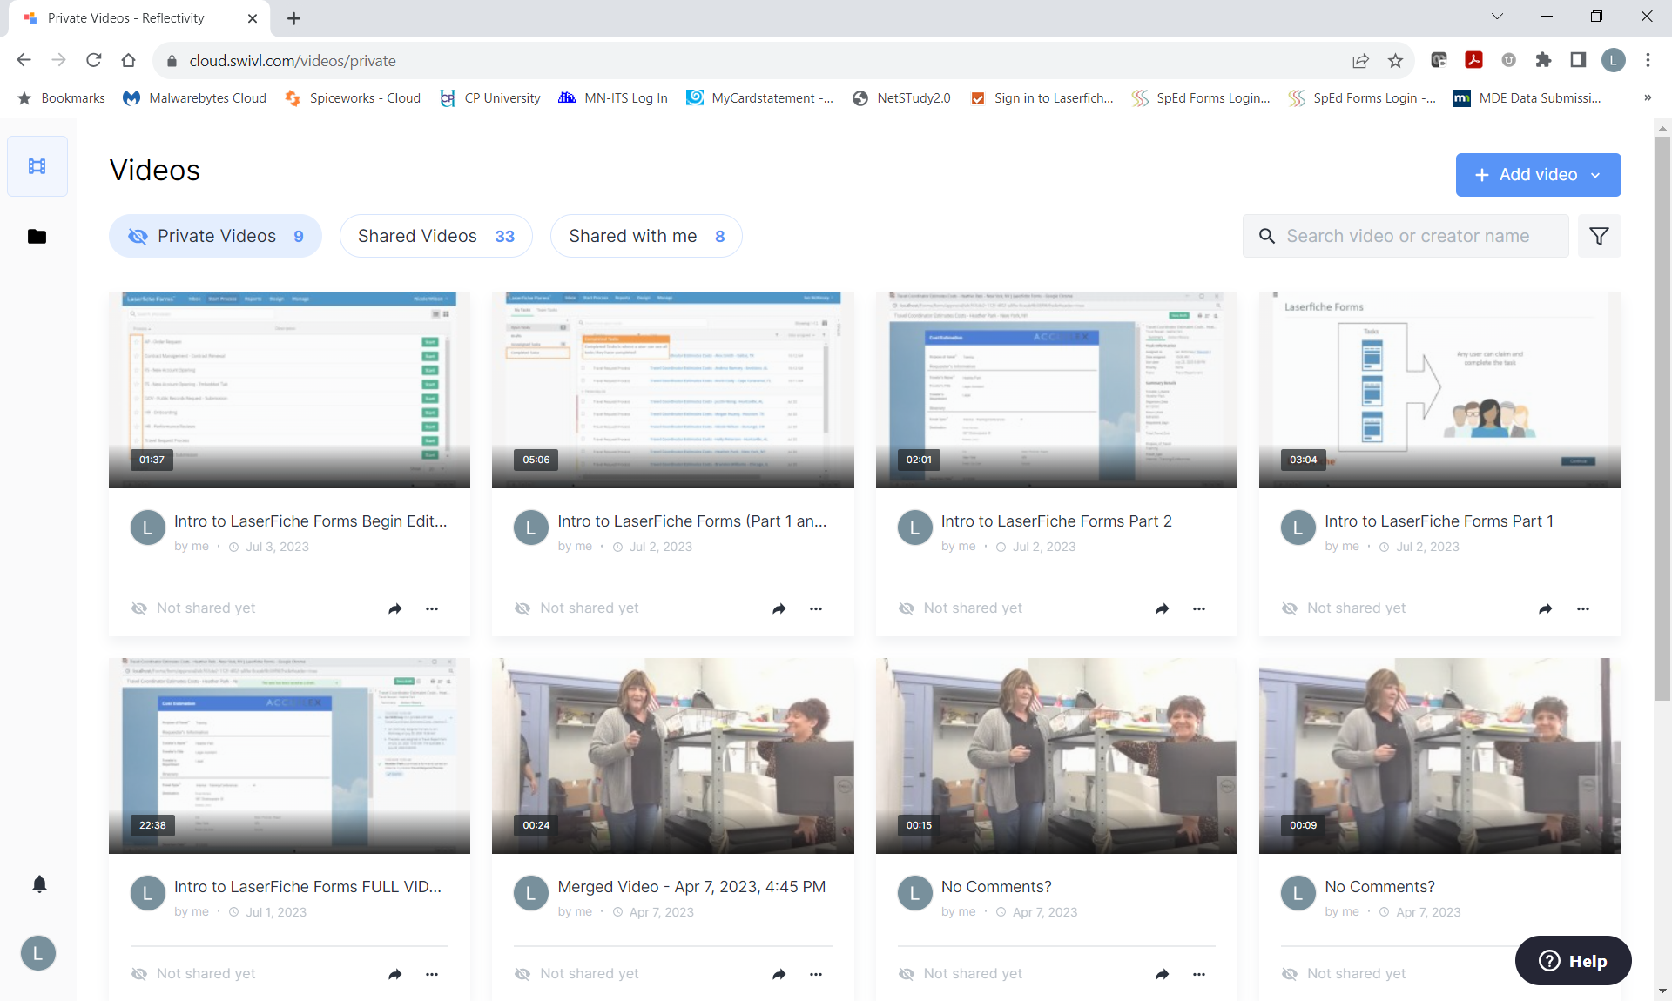
Reflectivity by Swivl Website
Dashboard landing page after logging into your account.

Slide 8
Reflectivity by Swivl Website
Private Videos: Videos you have recorded and that have been uploaded to your Reflectivity space.
Shared Videos: Videos that you have shared with other Swivl team members.
Shared with me: Videos that other Swivl team members have shared with you.
ADD VIDEO Button: Menu that provides options to upload a video from a device, or to record a video from another device (laptop with camera, etc)

Slide 9
Uploading a Video to Reflectivity
(from an existing video on your laptop)

Slide 10
UPLOAD a Video to Reflectivity
Although you can achieve the best capture and upload experience by using the Capture app in combination with your Reflectivity account, you can also upload a pre-recorded video (less that 5 GB) from your computer directly to your Reflectivity Library.
Click on the blue “Add Video” button and click on UPLOAD.
In the “Upload Video” box, either drag and drop the video or navigate to the video on your computer. Once your video is selected, the upload will begin.
After uploading of the video is complete you will have the option to select where to store your video in Reflectivity by Swivl, you can name your video, assign a description and tag your video.

Slide 11
Recording a Video From Your Laptop

Slide 12
Recording with Swivl:
The Website
Use your laptop camera and microphone to record a video directory to Reflectivity by Swivl.
Note: The preferred browser for this type of video capturing is Google Chrome or Firefox.
cloud.swivl.com/login

Slide 13
RECORD a Video to Reflectivity
Using the Swivl Robot gives you the flexibility to move around your classroom to capture video and learning content. You can also record a video using your laptop camera and microphone, but you will be limited in being able to move around freely. To record a video to Reflectivity by Swivl, follow the instructions on the next few slides:
Click on the blue “Add Video” button and click on RECORD.

Slide 14
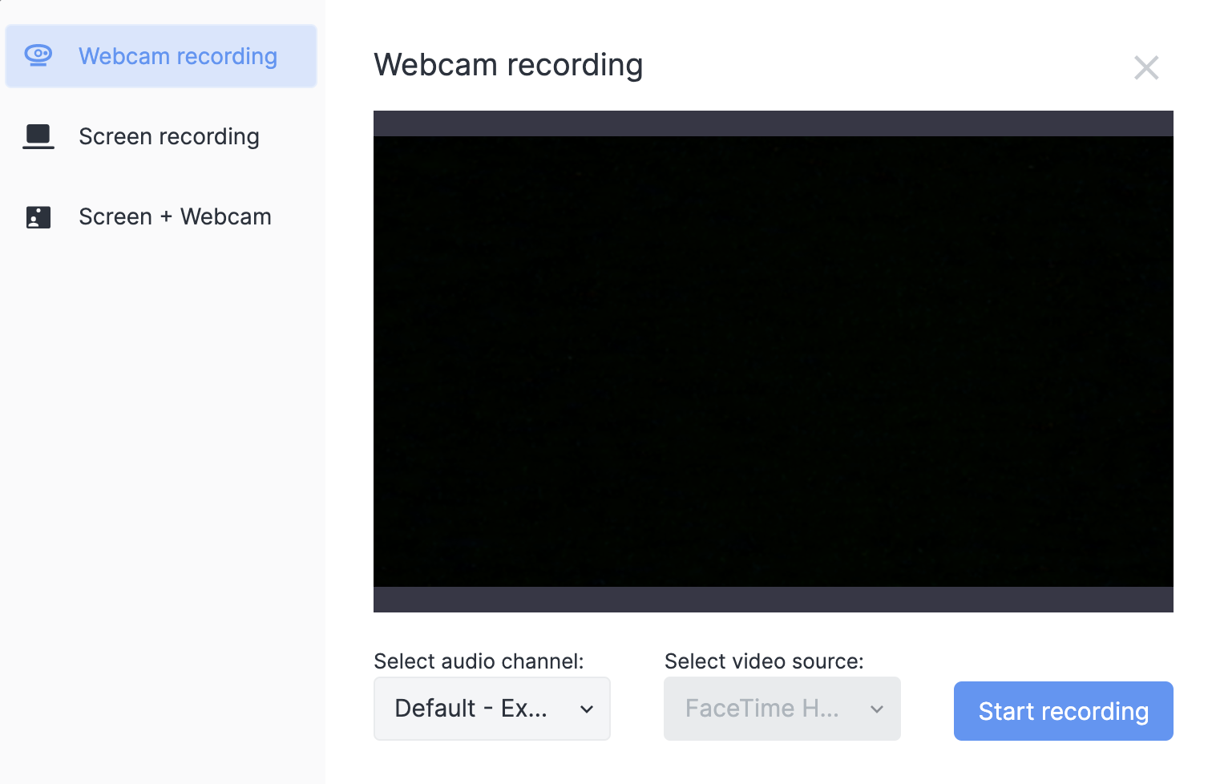
RECORD a Video on Reflectivity
Select your preferred recording option:
Webcam recording will record what your camera is focused on.
Screen recording will whatever is on your computer (screen).
Webcam and Screen will record both what your camera is focusing on and whatever is on your desktop.
Select your microphone.
Click Start Recording.

Slide 15
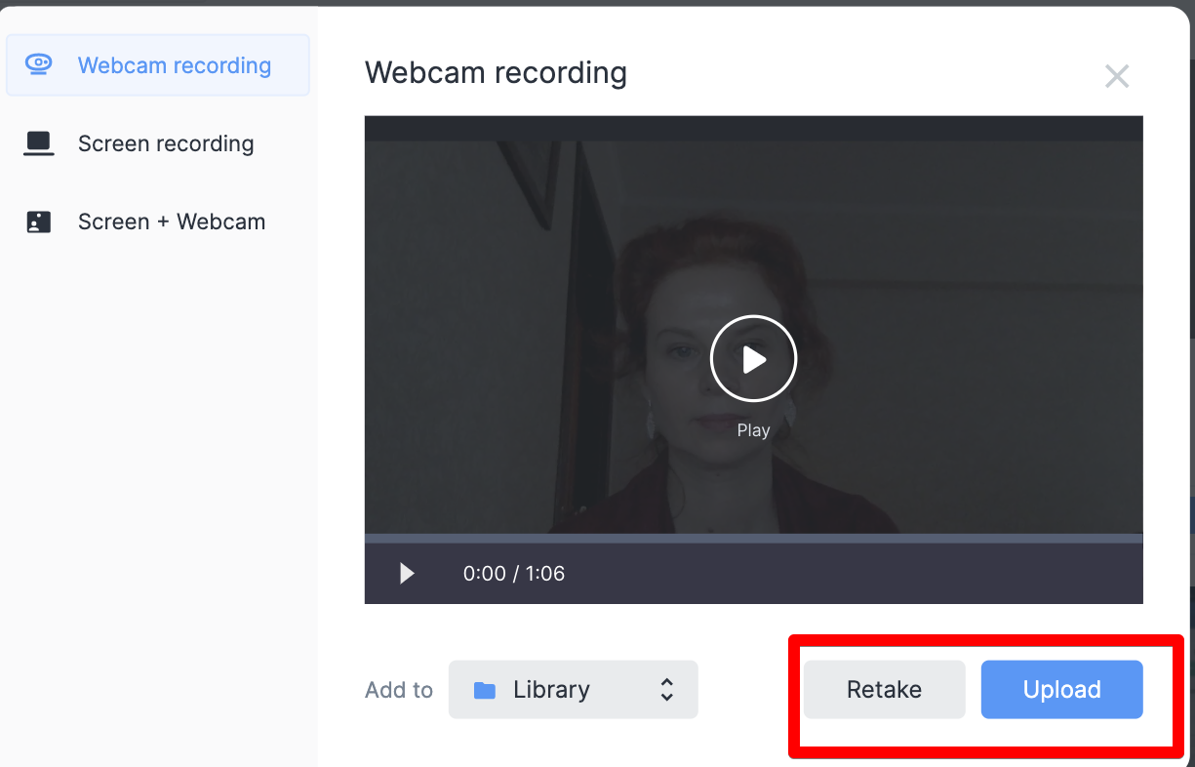
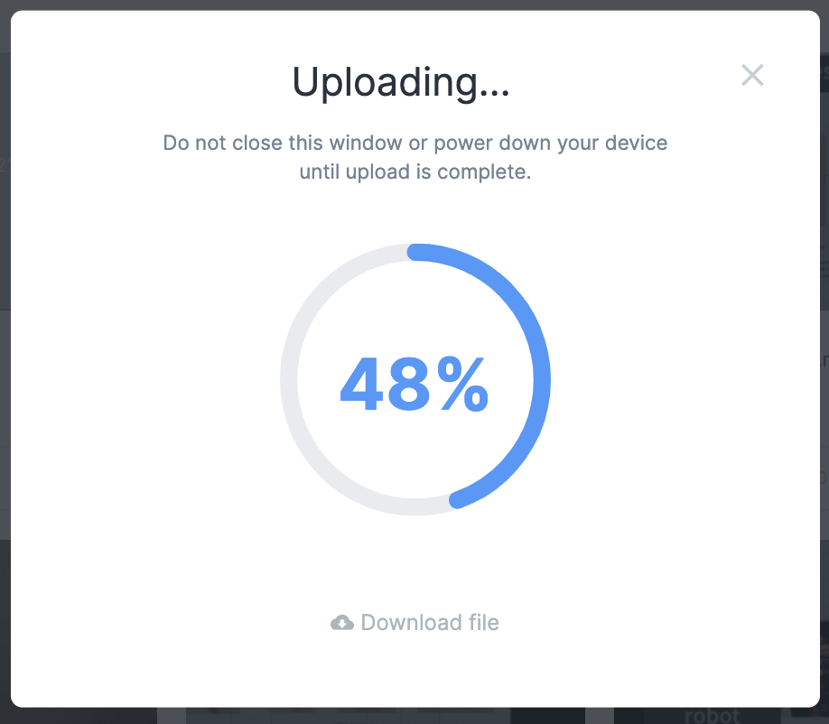
RECORD a Video on Reflectivity
While recording you can STOP or PAUSE/RESUME recording.
When you have finished recording (Stop), you will have the opportunity to UPLOAD or RETAKE your video.
After your video is uploaded you can name your video, give your video a description, and tag your project. Note: (tags are set up by the administrator. If you want a tag addd to the system, request that from your Program Manager).
Stop
Pause/Resume
NOTE: While your video is uploading, your laptop should NOT be closed, go into “sleep” mode, or shutdown. Your video needs to completely upload before closing, shutting down, or exiting Teams. All Head Start computers are initially configured to never go into “sleep” mode. If you’ve changed that setting you may want to ensure “sleep” mode is not configured.

Slide 16
Editing Videos

Slide 17
Video Editing
Video that is stored in Reflectivity by Swivl have several editing features available. There are some video that have limited video editing capabilities (such as screen recorded project, or multi-camera projects).
Editing options include:
TRIM – Trimming allows you to edit out portions of your video from the beginning or the end (or both) of a video.
CUT – Cutting allows you to edit the midsection of a video.
THUMBNAIL – Selecting the thumbnail feature lets you choose how your video appears to others when it is shared.
MERGE – Merging allows you to take two or three smaller videos and merge them into one larger, single video.
EDIT TITLE: You can edit the title, description, and tags (if available) for any video.
When using the trim, cut, and merge edit features, a copy of the original video file is created.
Using these features does not impact the original video.

Slide 18
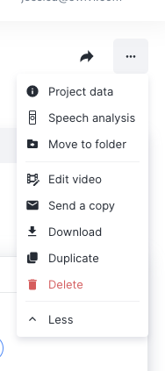
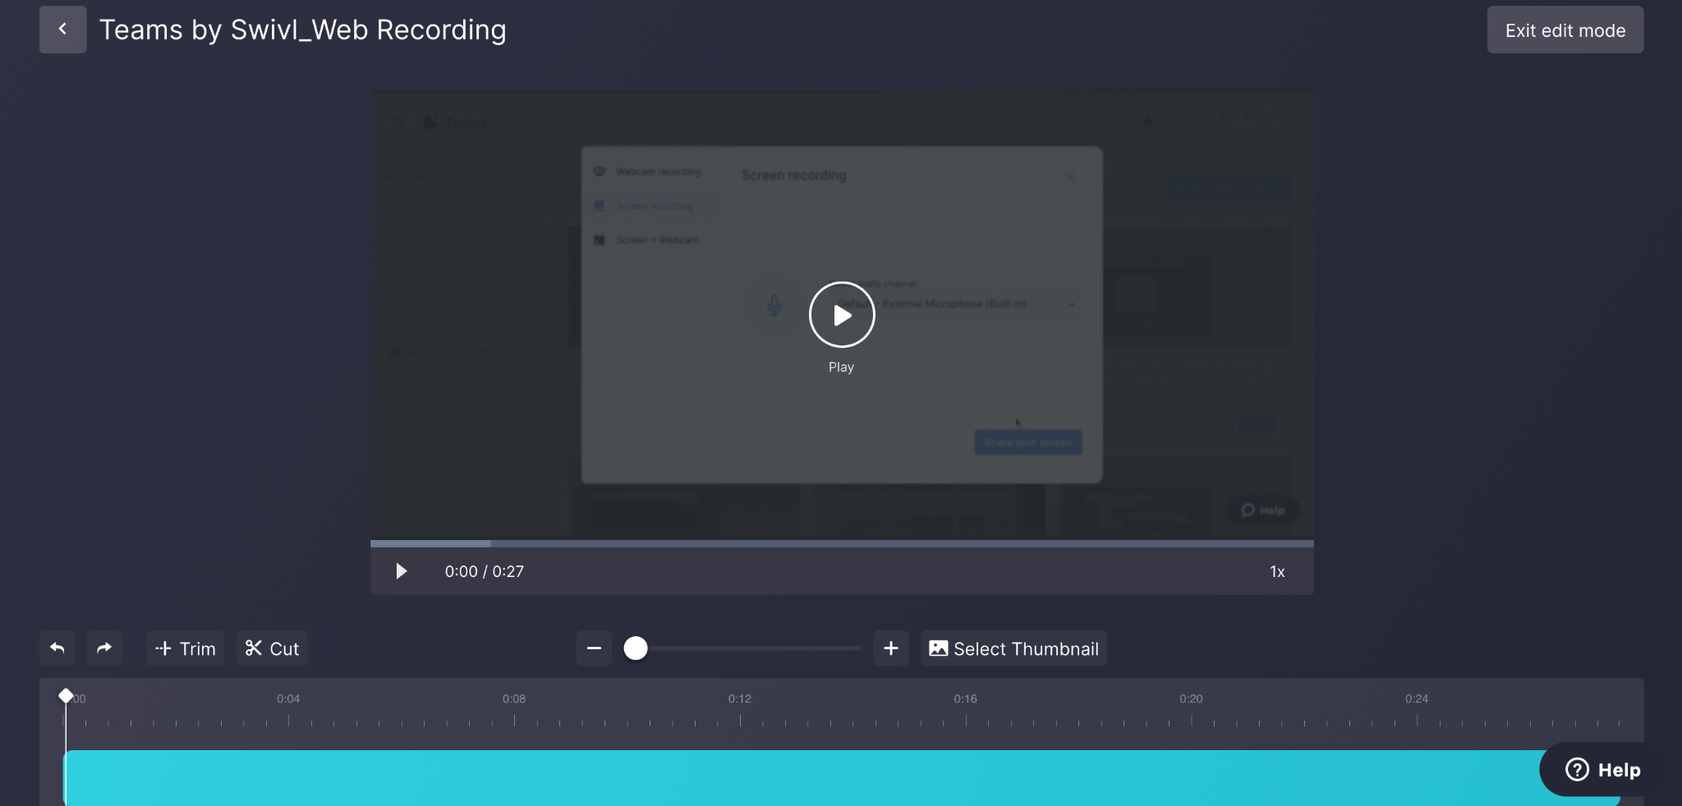
Video Editing
To edit a video:
Select the video from your LIBRARY (left click once on the video.
With the video open, click on the 3 dots (far upper right corner of the window)
Select MORE from the dropdown menu.
Select Edit Video.
You are able to TRIM the beginning and/or end,
CUT time out of the video, and change your Thumbnail.

Slide 19
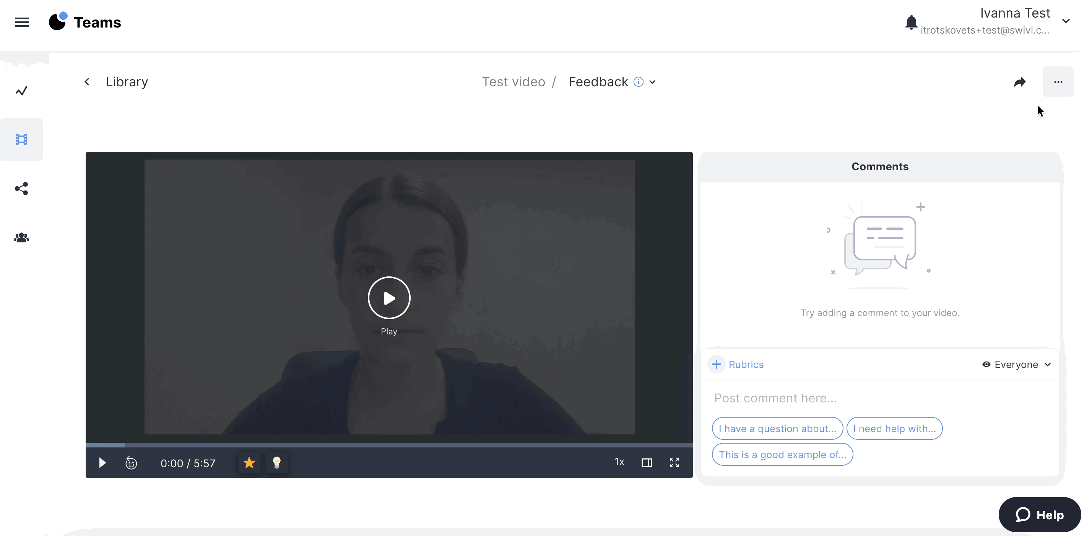
Video Editing – TRIM Feature
To TRIM a video:
Click on the TRIM button to enable the feature.
Drag the white sliders to select the area you want to trim.
Click on the APPLY TRIM button.
Click the SAVE button to save a copy to your video library.
Note: Your original video will remain unedited. A copy of the trimmed video will be saved.

Slide 20
Video Editing – CUT Feature
To CUT a video:
Click on the CUT button to enable the feature.
Move the sliders to select the area you want to cut (the red selected area will be removed).
Click on the APPLY TRIM button.
Click the SAVE button to save a copy to your video library.
Note: Your original video will remain unedited. A copy of the cut video will be saved.

Slide 21
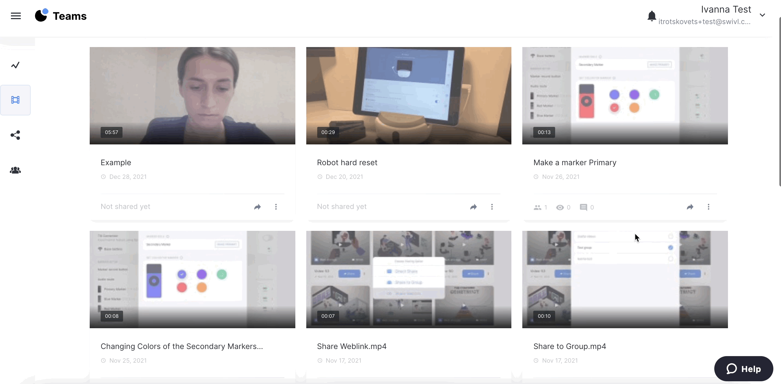
Video Editing – MERGE Feature
To MERGE videos:
In the video LIBRARY, select up to three videos you want to merge into one video by clicking on the blue square of each video (hovering over the videos).
Click the MERGE button that is located across the bottom of the window.
A merge dialog box will display where you can name the merged project and give the project a description.
Click the SAVE button to save a copy to your video library.
Note: Your original videos will remain unedited. A copy of the merged video will be saved.
**If you’ve selected more than 3 videos, the merge button will not be available (it will be greyed out)

Slide 22
Sharing Videos

Slide 23
Sharing Your Videos
When you upload a video to your Swivl Library, it remains private in your LIBRARY until you have chosen to share the video. However, as a Reflectivity member, all of your videos are visible by any Reflectivity administrator.
There are several ways to share your video:
Direct sharing with other Reflectivity members
Share to a group within Reflectivity
Share an unlisted weblink
Unshare
Duplicate Feature and Uses

Slide 24
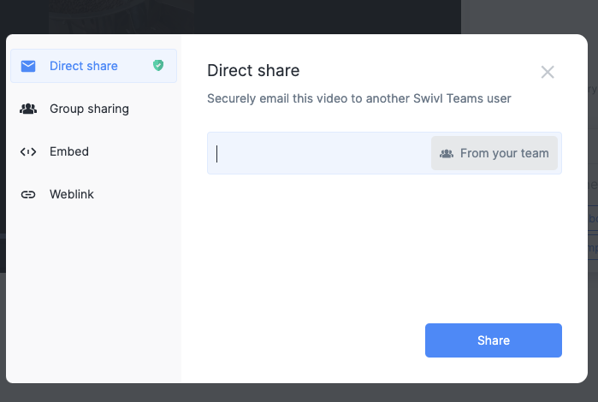
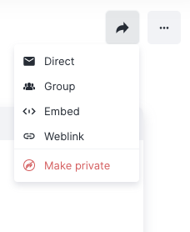
Share Your Videos - Direct
When you DIRECT share a video from your Library with one or more of your Reflectivity Swivl Teams members, they will receive an email notification that a video has been shared with them. They will be prompted to sign in to their Reflectivity Swivl account. They will watch the video from their FEED library. They will be able to leave comments on your video.
To share a video:
Select the video from your LIBRARY.
Note: You can either open the video OR use the Share arrow from the Library main screen.
Enter the email address of another Teams user, or select a name “From your team”.
Click on the Share arrow
Select DIRECT

Slide 25
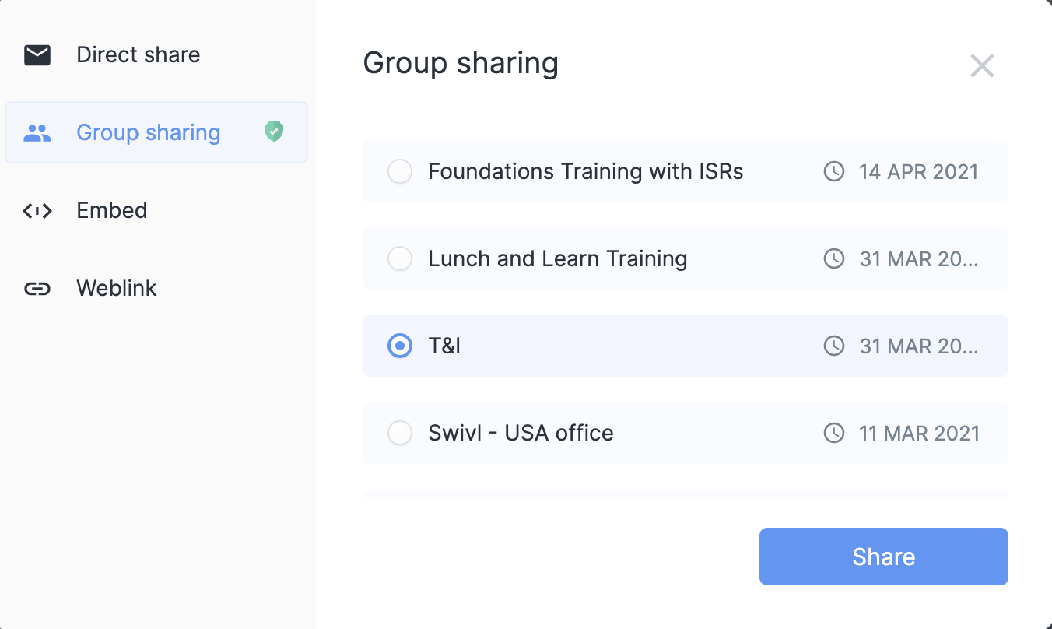
Share to a Group in Reflectivity
GROUP share a video from your Library with one or more GROUPS within Reflectivity Swivl Teams. Group members will receive an email notification that a video has been shared with them. They will be prompted to sign in to their Reflectivity Swivl account. They will watch the video from their GROUP library. They will be able to leave comments on your video.
To share a video:
Select the video from your LIBRARY.
Note: You can either open the video OR use the Share arrow from the Library main screen.
Choose the group you would like to share the video to and click Share.
Click on the Share arrow
Select GROUP

Slide 26
Generate a Weblink
Sharing an UNLISTED WEBLINK allows you to share videos outside of the Reflectivity Swivl platform (software). Note that by sharing a weblink to your video, your video will no longer be fully private or secure (because it’s possible Non-Swivl users could “reshare” your weblink).
To share a video:
Select the video from your LIBRARY.
Note: You can either open the video OR use the Share arrow from the Library main screen.
Click on the COPY WEBLINK
With the weblink address copied, you can now paste that address in an email to any Non-Swivl Teams email address.
Click on the Share arrow
Select WEBLINK

Slide 27
Make a Shared Video Private (Unshare)
To UNSHARE a video:
Select the video from your LIBRARY.
Note: You can either open the video OR use the Share arrow from the Library main screen.
Click on the Share arrow
Select Make Private
If you set this project to private, it will be removed from the feeds of users and groups where it was previously shared.
Weblink access will no longer be accessible.

Slide 28
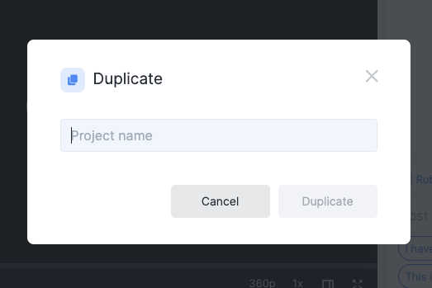
Duplicate a Video in Reflectivity
The DUPLICATE feature enables you to copy a video in your LIBRARY without copying comments and removes any shared Reflectivity TEAMS members or Reflectivity TEAMS groups.
To DUPLICATE a video:
Select the video from your LIBRARY (left click once on the video.
With the video open, click on the 3 dots (far upper right corner of the window)
Select MORE from the dropdown menu.
Select Duplicate.
In the pop up, enter a new title for the duplicate version. You will still have the original video.

Slide 29
Happy Editing!

