Slide 1
Swivl Recording & Swivl Reflectivity

Slide 2
Contents:
Recording with Swivl
Using Swivl app for asynchronous recording
Asynchronous learning refers to recorded sessions where parents and children can access the video recording any time that works for them. There is no “live” active participation by the parents and children viewing the video.

Slide 3
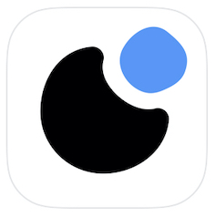
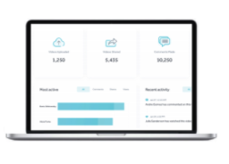
Swivl Robot + “Reflectivity” by Swivl
The Swivl Robot rotates to track the teacher while the included Marker(s) capture high quality classroom audio.
Video captured is securely stored meeting data privacy requirements of FERPA (Family Educational Rights and Privacy Act) and COPPA (Children’s Online Privacy Protection Act).
Record, host, and share videos for self-reflection, professional development, teacher and parent observations.
Videos can be time-stamped with commenting and includes built-in rubric support (objective assessment scoring).

Slide 4
Teams by Swivl Components
Swivl Robot
Capture iPad App
Teams Website
Rotates to easily track and record the person wearing the primary marker.
Multiple microphones (Markers)
iPad app used to record or stream video. Used in conjunction with the robot. Video can be automatically uploaded to the Refelectivity secure cloud space.
See all of your content! View, edit, share, and collaborate.

Slide 5
Live Streaming vs. Recording
Live streaming is conducted using:
The Swivl Robot
iPad
Swivl Capture App on the iPad
Zoom integrated tool within the Swivl App
Swivl Reflectivity Software
Recorded video is conducted using:
The Swivl Robot
iPad
Swivl Capture App on the iPad
Swivl Reflectivity Software

Slide 6
Live Streaming vs. Recording
Learning isn’t the only use for live streaming or recording video. Other uses could include:
Recording portions of the classroom day for TLC or other training opportunities.
Recording portions of the classroom day for use in the Head Start training library (best practice situations).
Recording portions of the classroom day to share with parents.
Recording a parent training topic to share with parents.
Recording portions of the classroom day to capture child behavior.
Live streaming the classroom for classroom observations.
Live streaming the classroom for coaching purposes.
Live streaming the classroom for behavior management assistance.
Live streaming the classroom for new teacher mentoring from a distance.

Slide 7
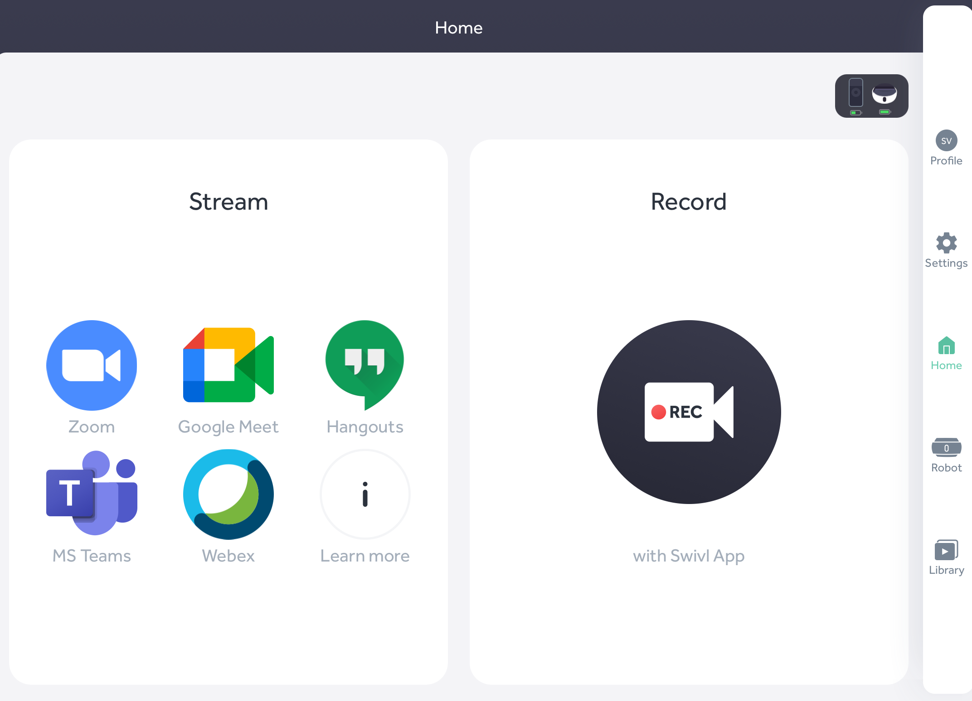
Recording with Swivl:
The Capture App

Slide 8
iPad Capture App Settings
Menu Options:
SETTINGS (gear icon)
On the “ALL” tab in the menu check the following (preferred options):
Recording Section - Video Quality = HD (high definition)
Uploading Section – Auto-upload should be turned on
Uploading Section – Storage saver should be turned on
Advanced Settings – Multi-Marker Bookmarking – turn this on if you want all markers to bookmark during a video. Default is the primary marker only.
ROBOT icon:
**Auto-Tilt during Tracking – should be turned on
Marker Set Up Section – Marker Record Button – in the options menu, select Start/Pause/Resume Recording (best option)
**Note: if the robot is not tilting correctly during recording, double check the auto-tilt settings. If that setting is turned on, it may be that the room is too dark (if the lights are all off). Try adding some light to see if the robot tilts correctly.

Slide 9
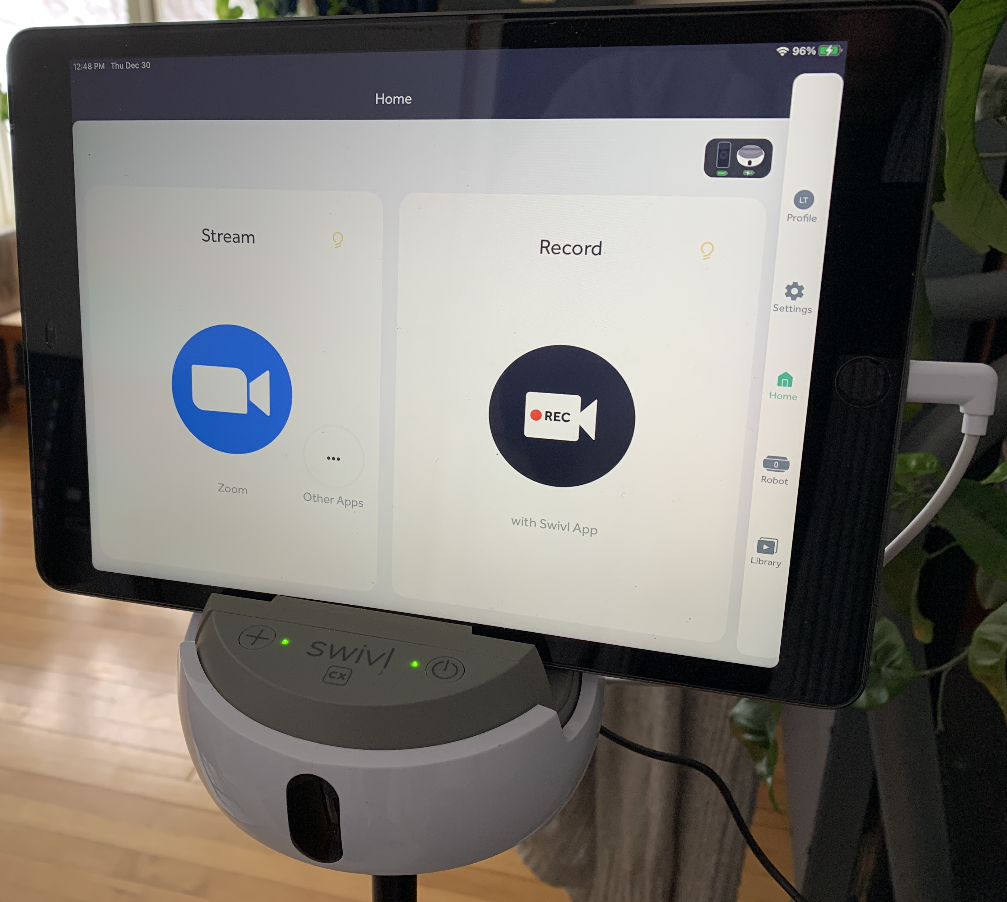
Setting up to Record
Set up:
Swivl Robot
Connect the iPad to the robot
Turn on Primary Marker
Make sure your robot, markers, and iPad are fully charged before beginning recording

Slide 10
Starting a Recording
Within the Teams app “Home” screen, tap on Record.

Slide 11
Starting a Recording
This shows your recording time limit.
On the Capture screen, start your recording by tapping Rec,
OR by pressing the red button on your Primary marker (on the side of the marker).

Slide 12
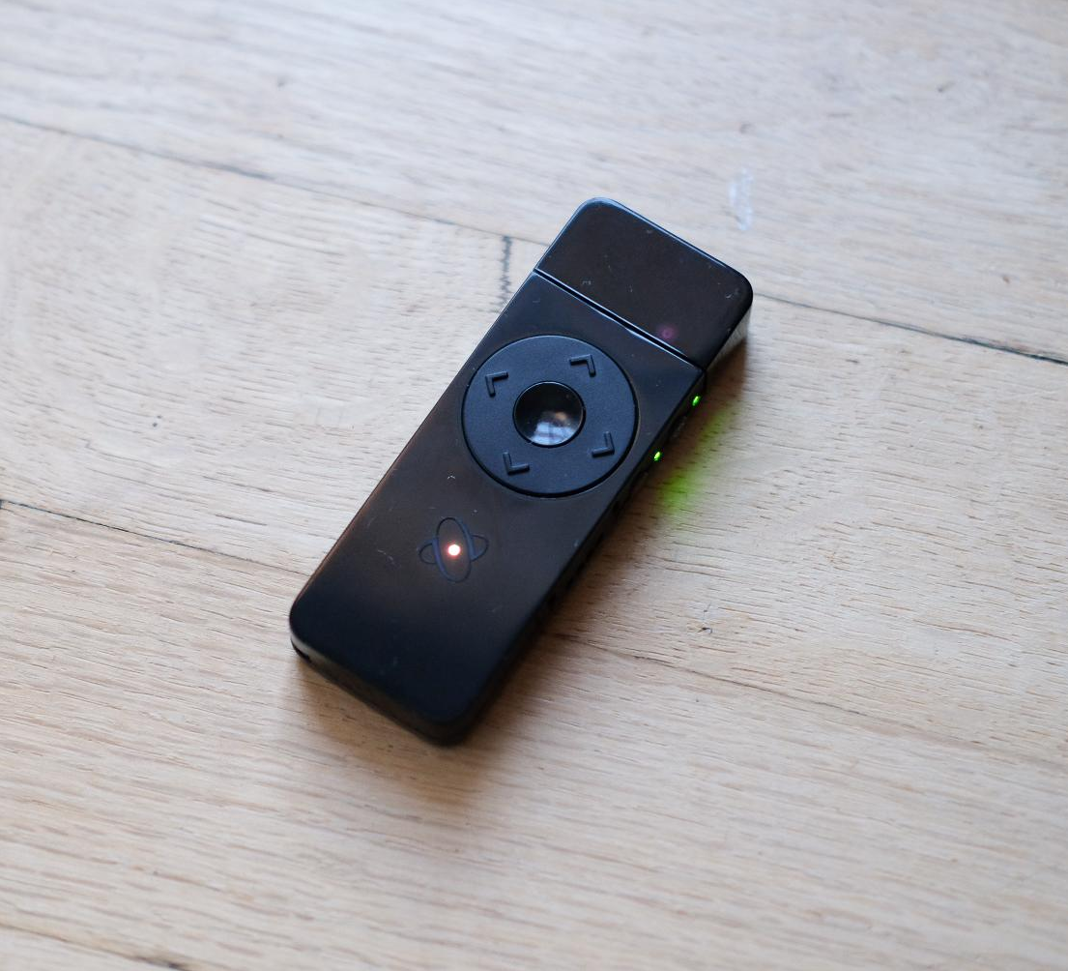
Bookmark during Recording
Quickly mark a point in the video to view later.
While recording, create a bookmark by pressing the up or down arrow on the Primary Marker.
***Pro Feature***

Slide 13
Stopping a Recording
Tap on the Stop button to stop your recording,
OR press the red button on the Primary marker again (on the side of the marker).

Slide 14
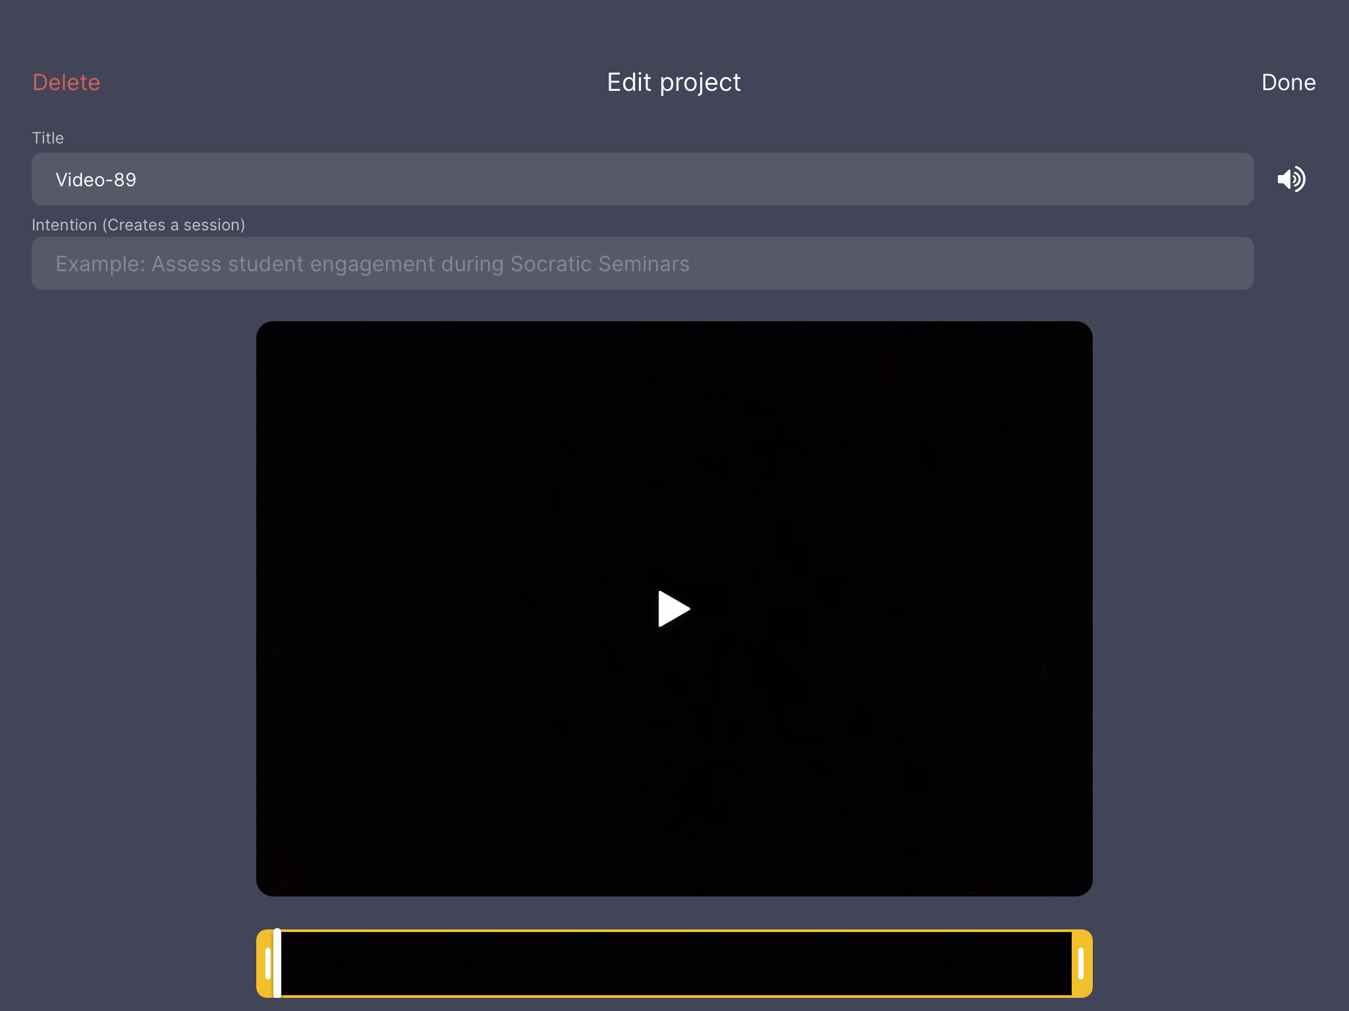
Saving a Recording
On the Edit project screen, you can:
Change the title
Turn off the audio
Trim the video
Then click Done.

Slide 15
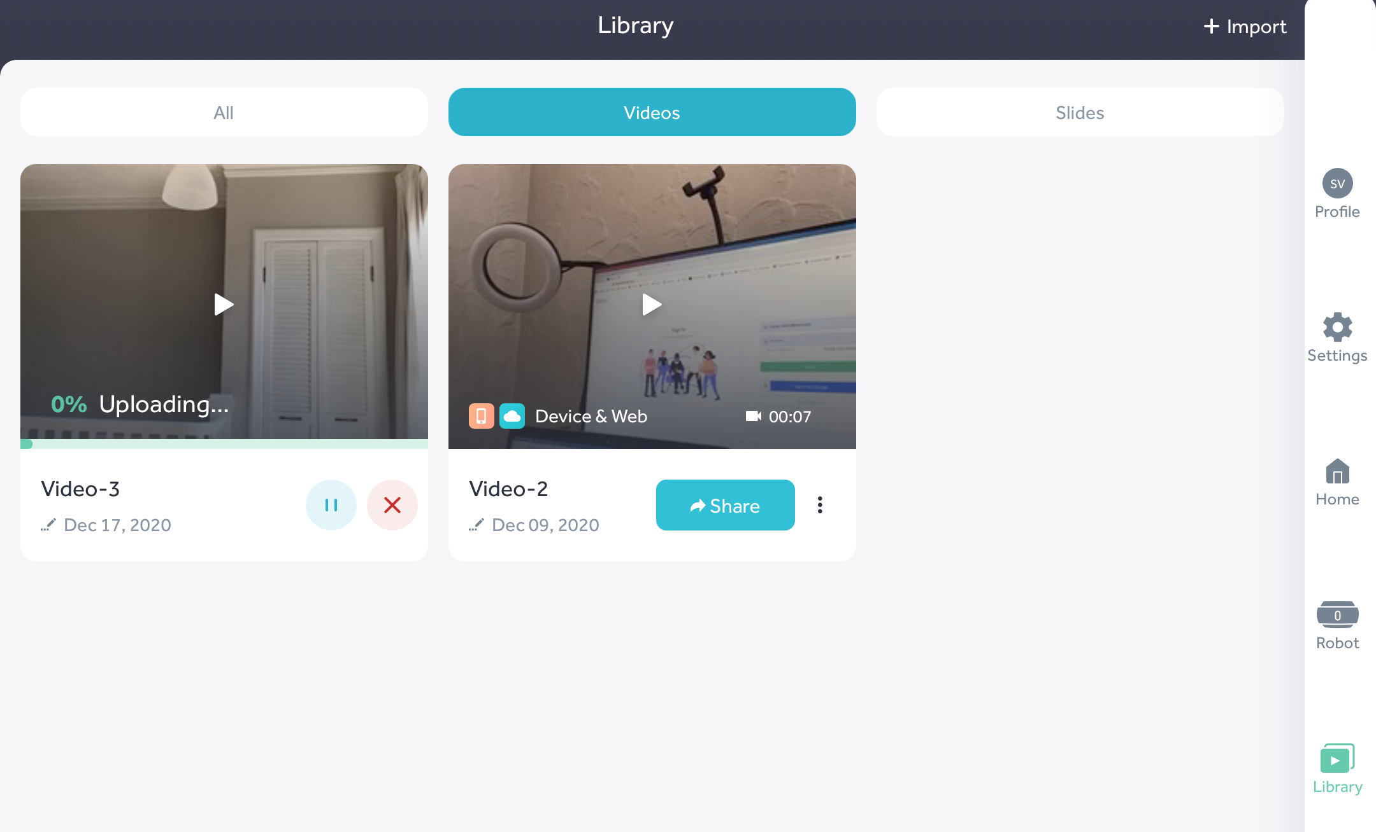
Saving a Recording
Your video will upload to your iPad app’s library,
and your Reflectivity by Swivl library automatically - if this is selected in your Settings
(on the iPad).

Slide 16
Prior to these steps, make sure slide 14 is completed… Set up your robot, iPad, and marker. Record a video practicing how use the buttons on the Primary marker to: 1. start recording 2. pause/resume the video 3. mark your video in multiple spots

