Slide 1
Swivl iPad Setup Guide

Slide 2
Contents:
Get to Know the Robot
Swivl Robot Mobile Device Grip, Ports, and LEDs
Charging & Battery Life
Markers
Primary vs. Secondary

Slide 3
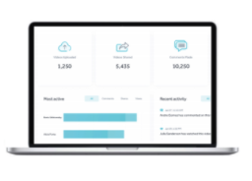
Swivl Robot + Reflectivity by Swivl
Swivl Robot rotates to track the teacher while the included Marker(s) capture high quality classroom audio.
Video captured is securely stored meeting data privacy requirements of FERPA (Family Educational Rights and Privacy Act) and COPPA (Children’s Online Privacy Protection Act).
Swivl Capture (iPad App) will record, host, and share videos for self-reflection, professional development, teacher and parent observations.
Videos can be time-stamped with commenting and includes built-in rubric support (objective assessment scoring).
Provide hybrid and distance learning opportunities to remote students.

Slide 4
Teams by Swivl Components
Swivl Robot
Swivl CaptureApp
Teams Website
Rotates to easily track and record the person wearing the primary marker.
Multiple microphones (Markers)
iPad app used to record or stream video. Used in conjunction with the robot. Video can be automatically uploaded to the Reflectivity secure cloud space.
See all of your content! View, edit, share, and collaborate.

Slide 5
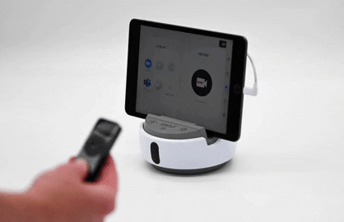
Swivl Robot

Slide 6
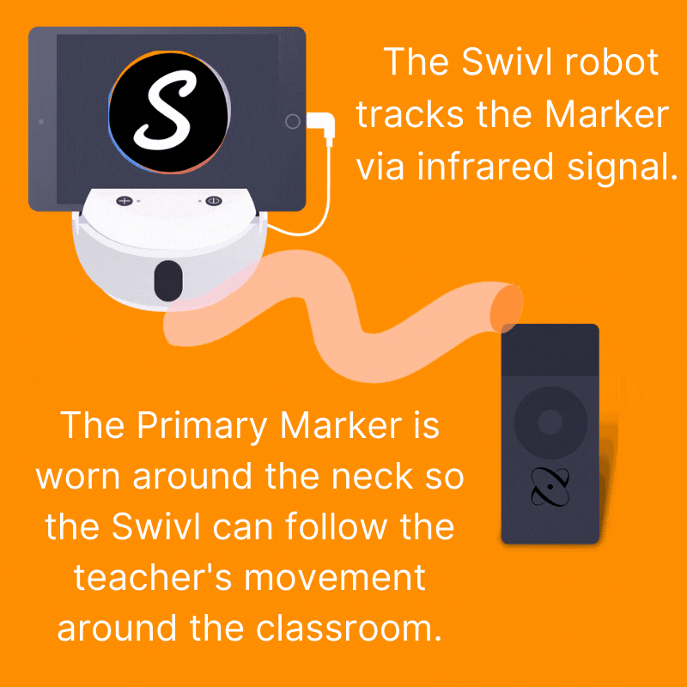
How Swivl Works

Slide 7
How Swivl Works

Slide 8
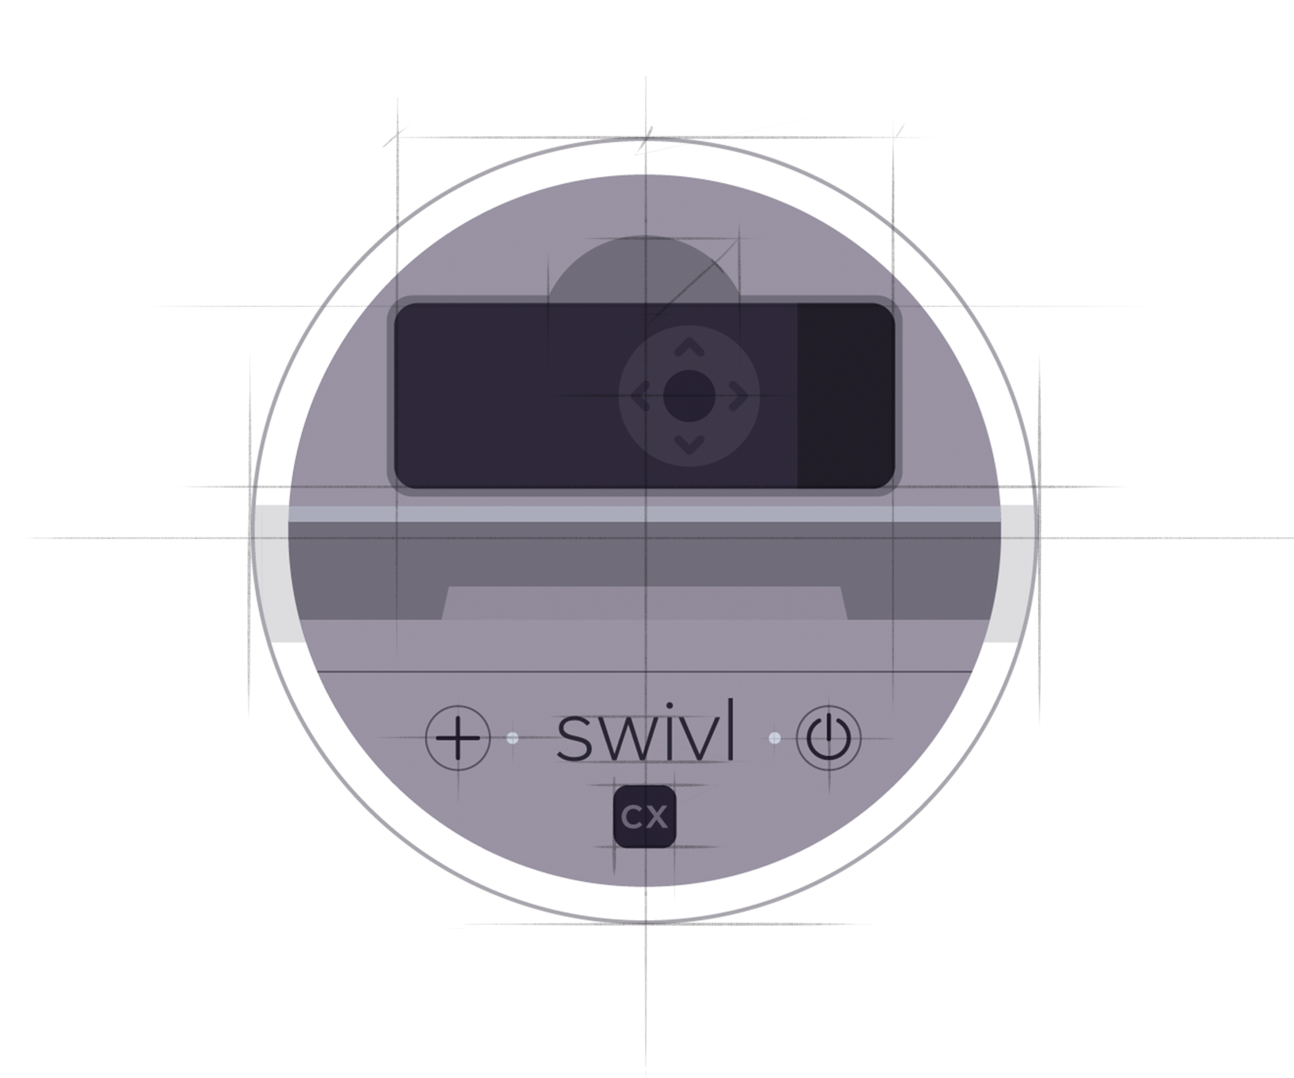
Get to Know the Swivl Robot

Slide 9
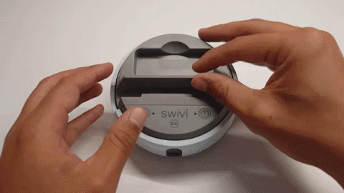
Adjust the Grip (if necessary)
Head Start iPads are equipped with a protective case. You should remove the iPad case to better fit in the robot. After removing the iPad case, you may need to adjust the grip to a different shim to better fit the iPad snuggly. Shims are provided in the Swivl kit.
Slide the grip to the left.
Lift the grip out of the base.
Replace the shim.
Align the grip back in the grooves of the base and slide it to the right.

Slide 10
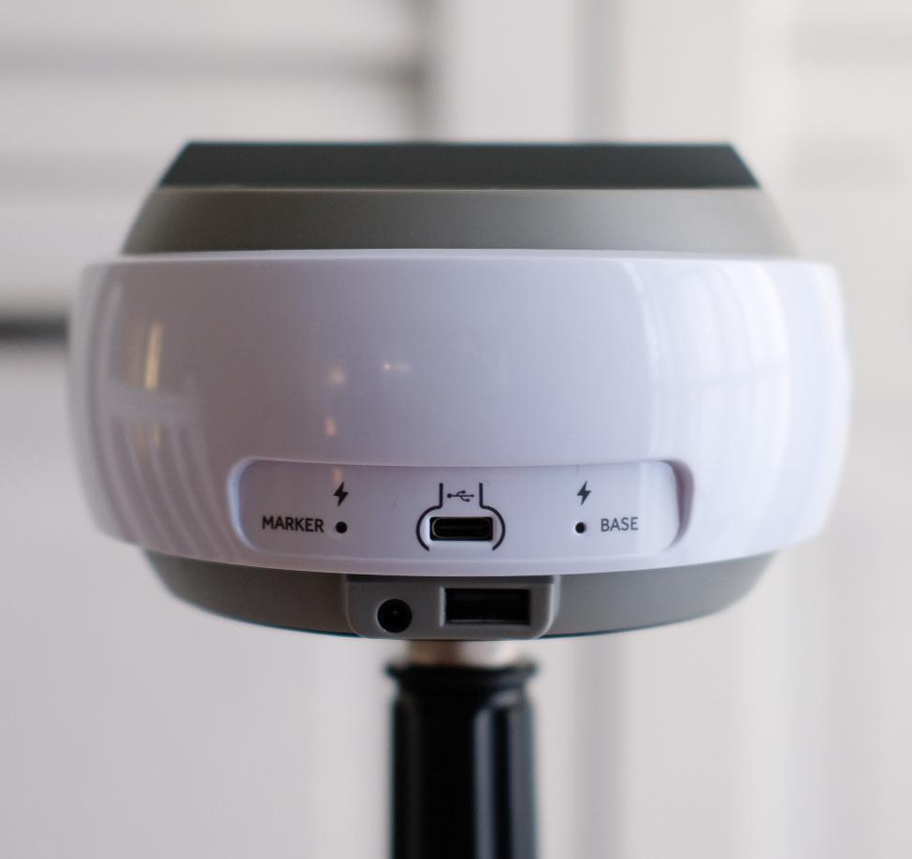
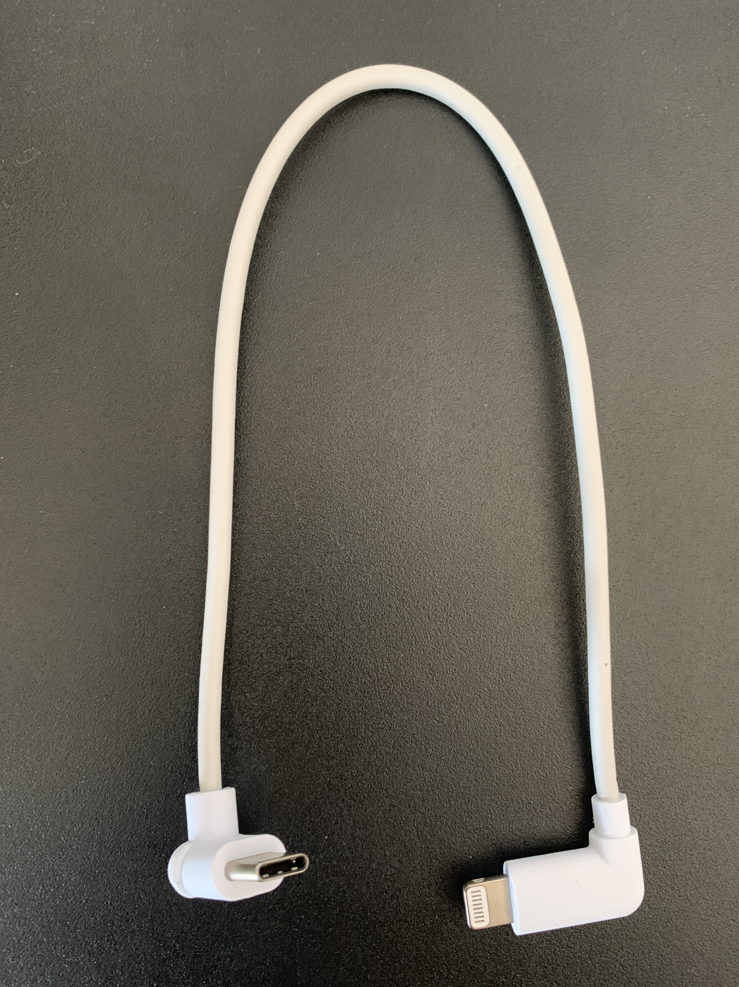
Swivl Robot Ports
Connect iPad using this WHITE cable to the robot here
Connect USB-A Cable or USB speakers (AC adapter) here.
Speakers are not required, but could be used to project remote learners voices to the whole classroom (used for live streaming)
Note: there is a black cable that looks similar to this white cable. You will not use that cable. It is intended for non-iPad devices.
Charge Base here

Slide 11
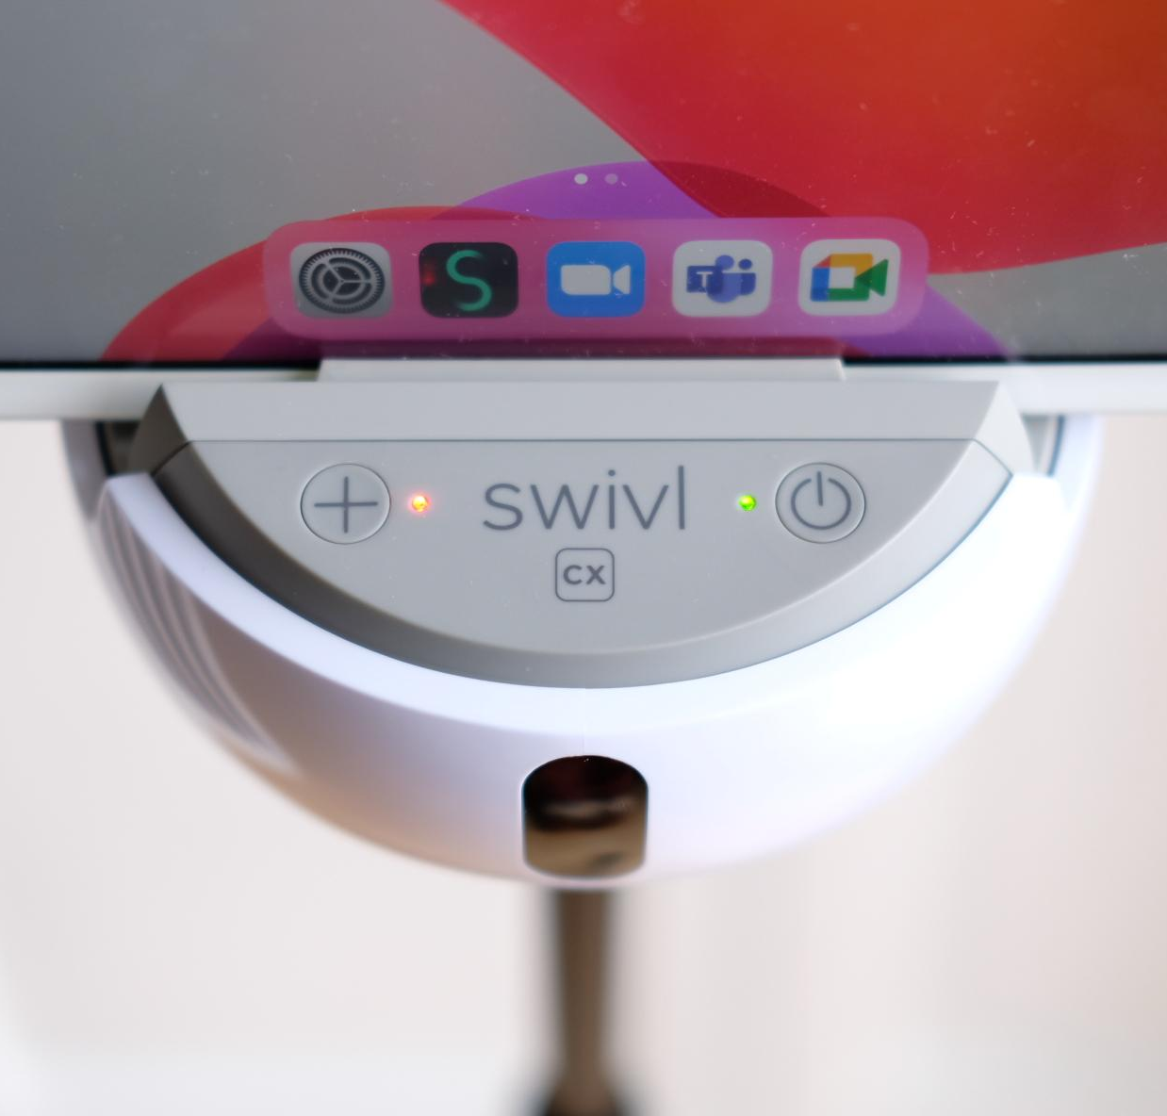
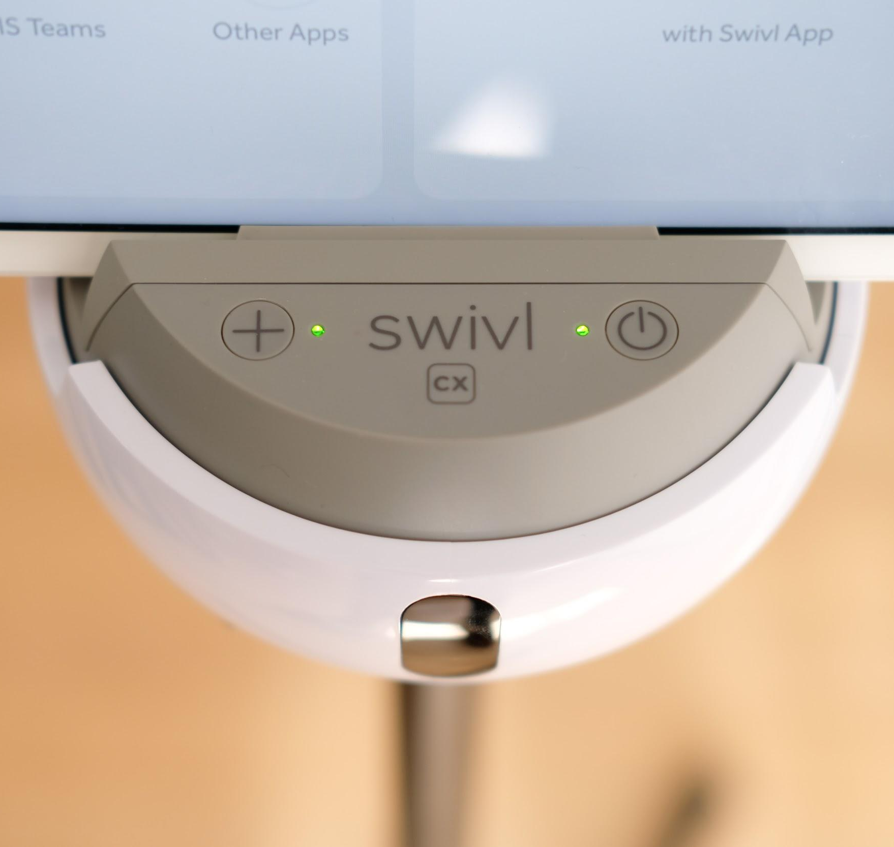
Swivl Robot Indicator LEDs
Solid Green Light: iPad successfully connected
Both Lights Green:
Marker is connected and iPad is detected.
Solid Red Light: No Marker connection
Before recording, always verify Primary Marker’s status in Swivl app.

Slide 12
Swivl Robot Indicator LEDs
Markers and Base device updates:
Markers will only update when placed in the base and the iPad “Capture” App is open.

Slide 13
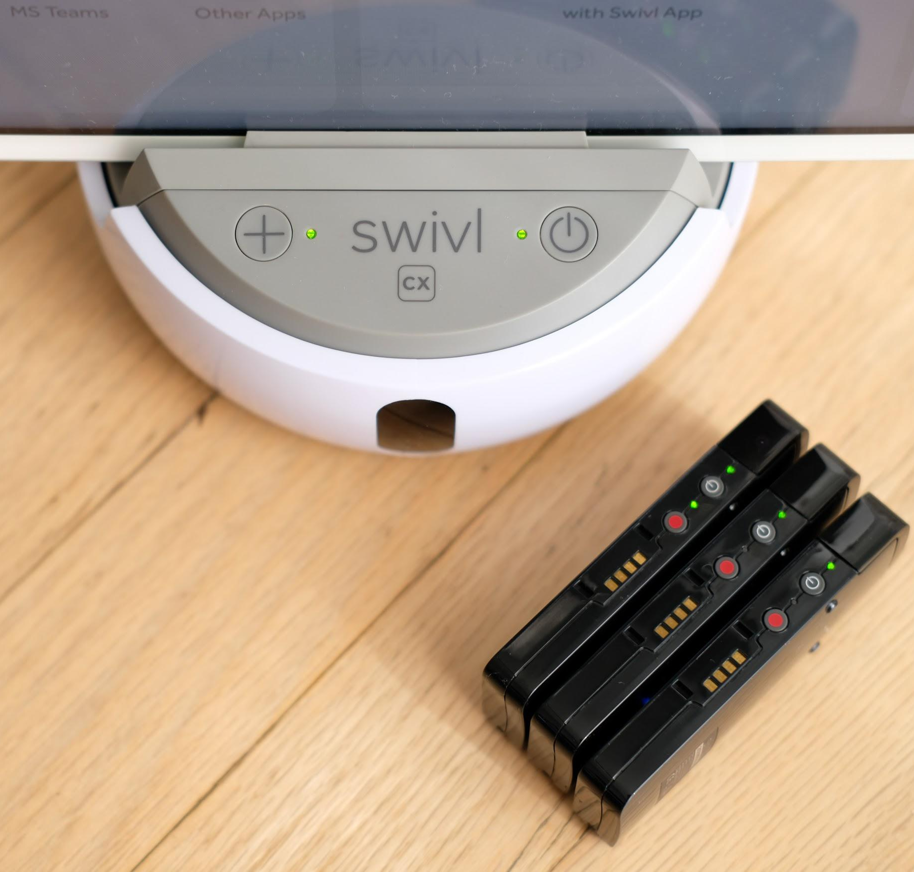
Charging & Battery Life
Charge lasts for 4-6 hours.
Best Practice Tips:
If you will be using the Swivl Robot on a consistent basis:
Set up a regular daily charging routine.
Charge Swivl Robot and Markers nightly.

Slide 14
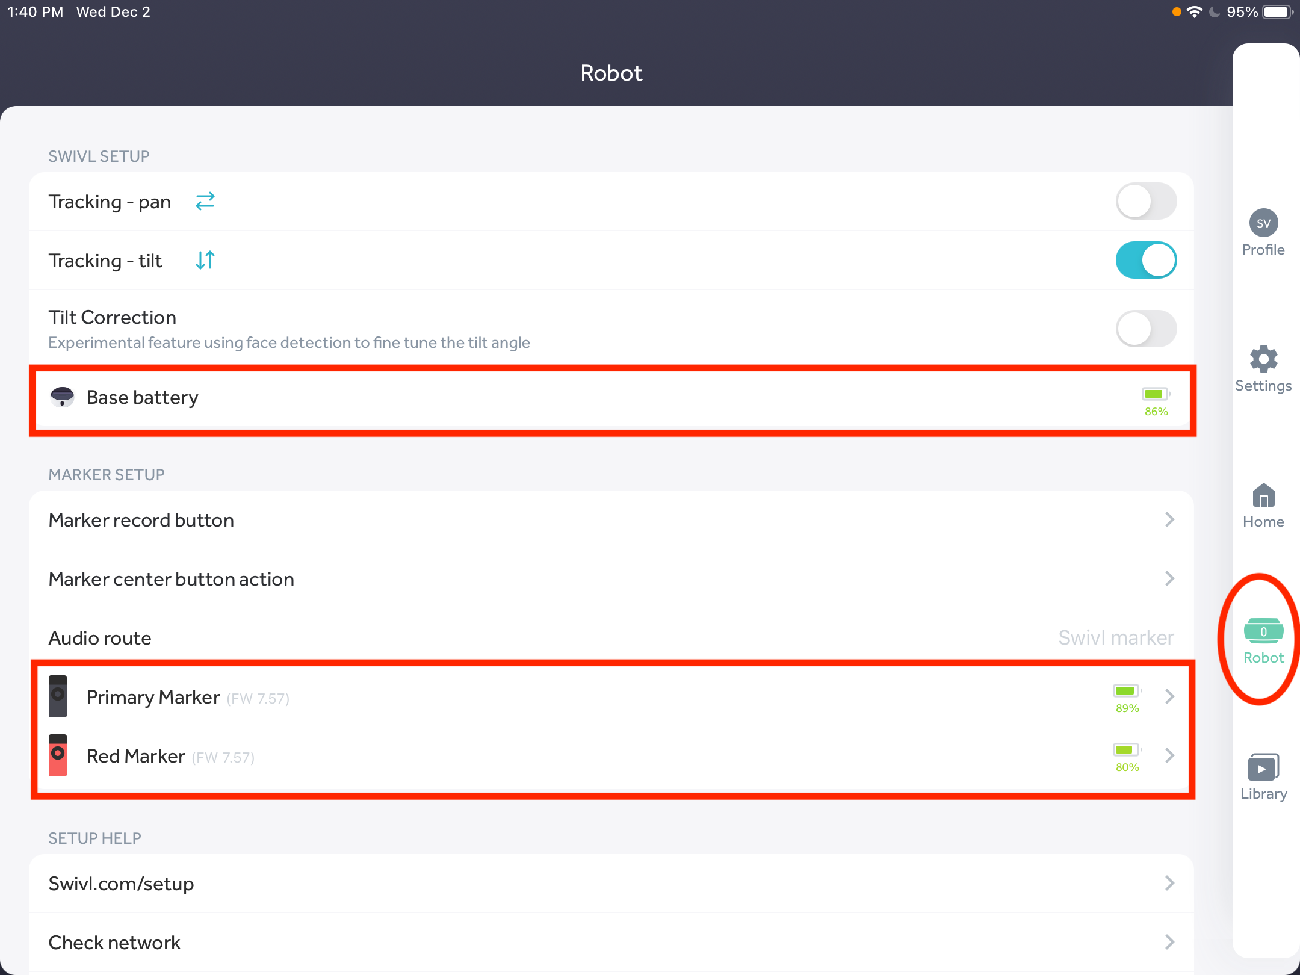
Checking the Battery Status
Within the Swivl App (on the iPad):
Go to Robot Settings to check the Base and Marker battery status.

Slide 15
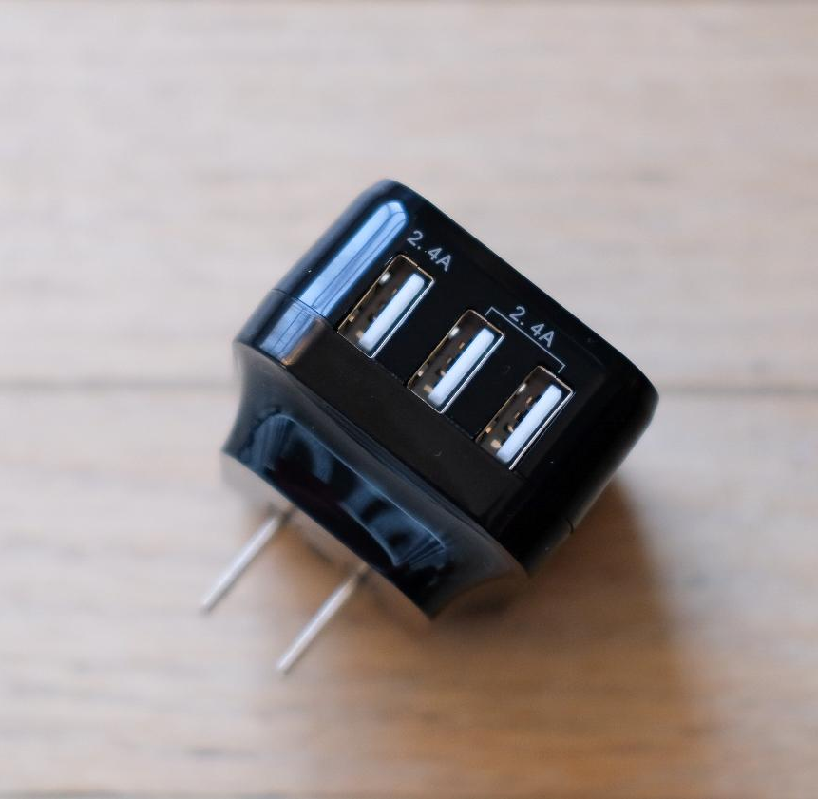
Charging Swivl Markers: CX
Best Practice Tip:
Charge 3 Markers at once by:
placing 1 marker in Swivl Base
and charging 2 markers on the hammerhead cable.
See next slide for setting up charging of all markers and robot at one time.

Slide 16
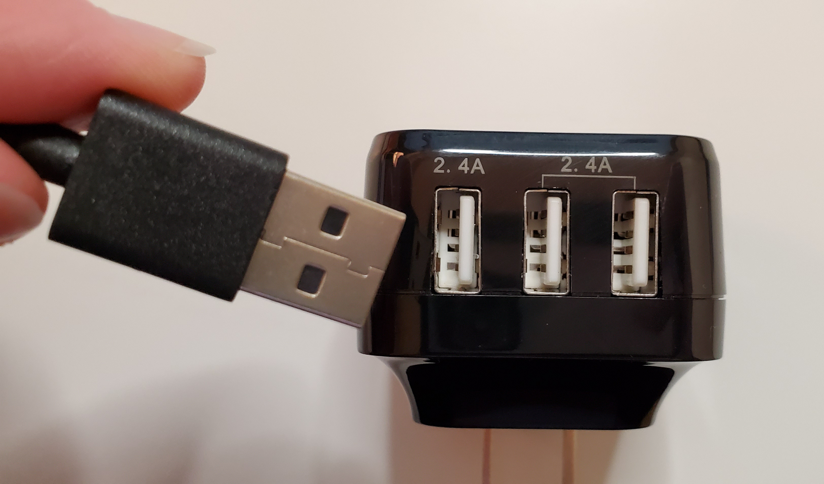
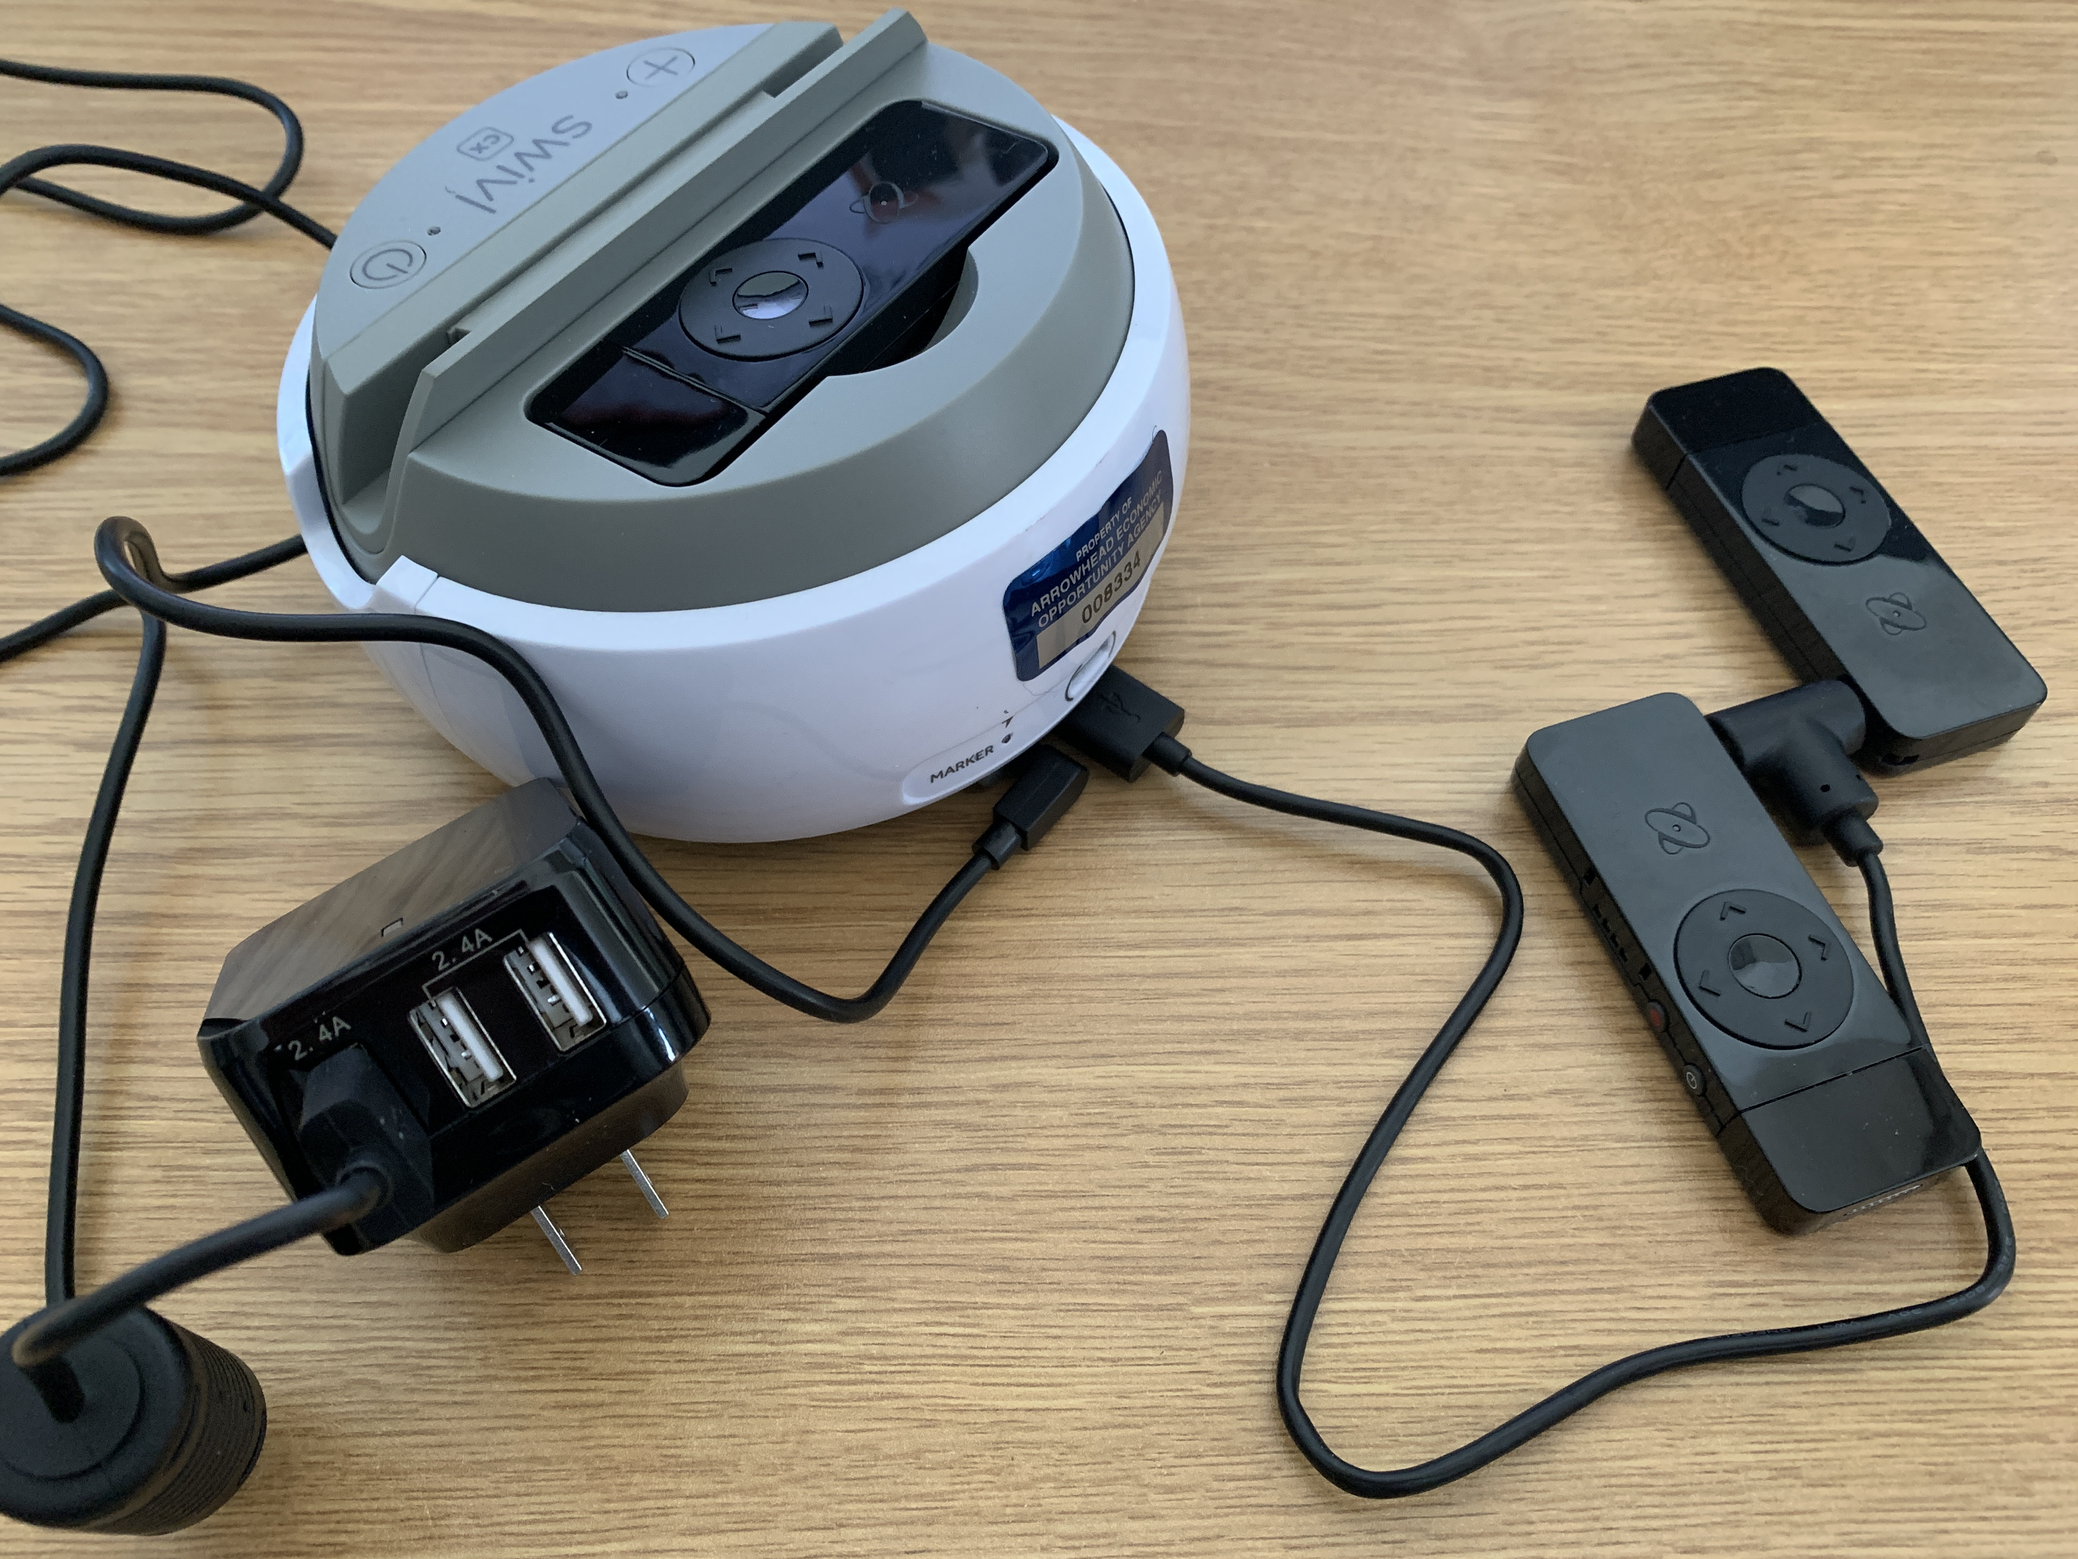
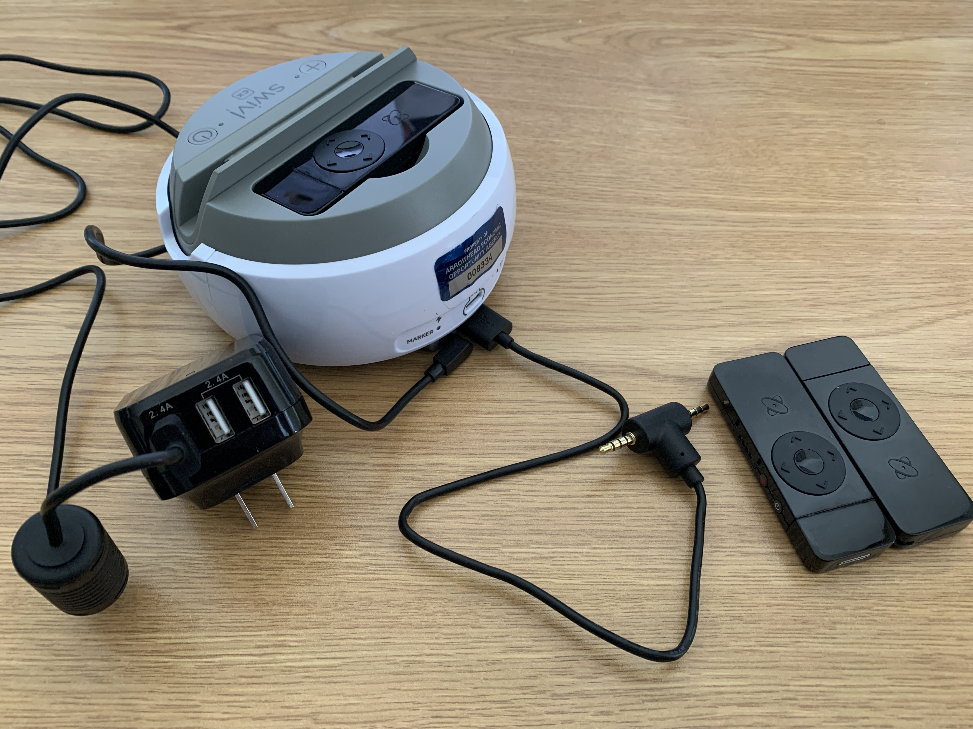
Charging the Robot and Markers
Step 1: Plug the base charging cable (USB end) into the left side 2.4 A port on the USB 4 port charging block.
Step 2:
Plug the “hammerhead” cable into the robot USB port (on the back of the robot).
Plug the base charging cable into the power port (on the back of the robot).
Step 3:
Plug each secondary marker into the “hammerhead” cable.
The primary marker is charged in the robot charging dock on the top of the robot.
Plug the black USB 4 port charging block into a wall outlet.

Slide 17
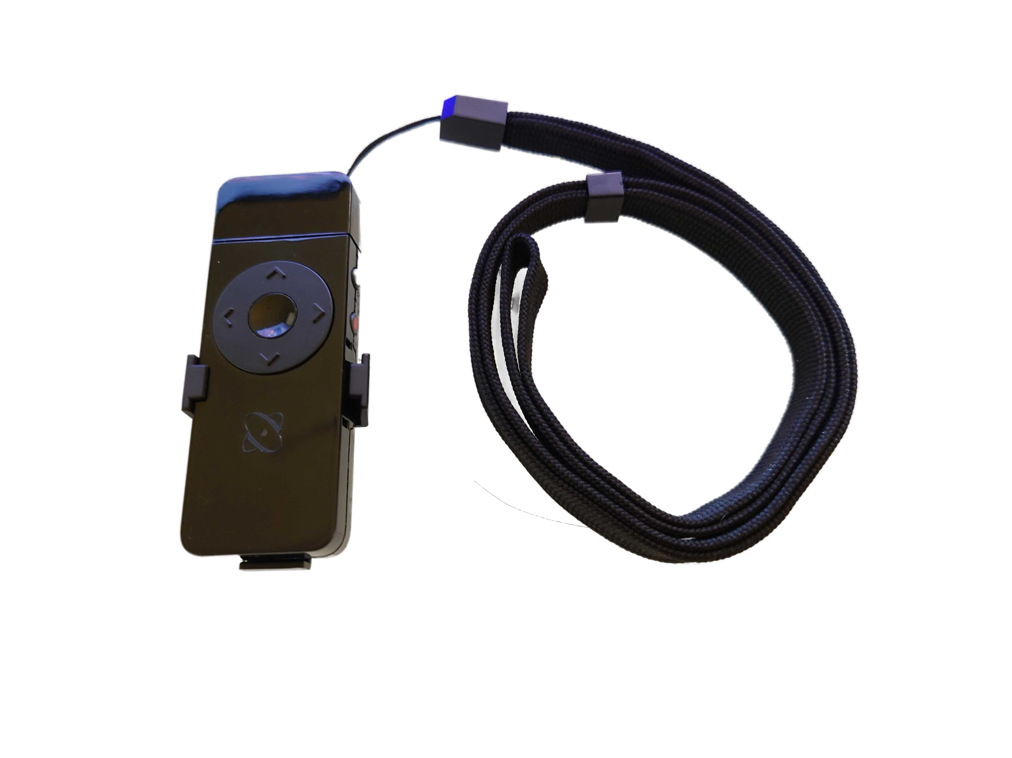
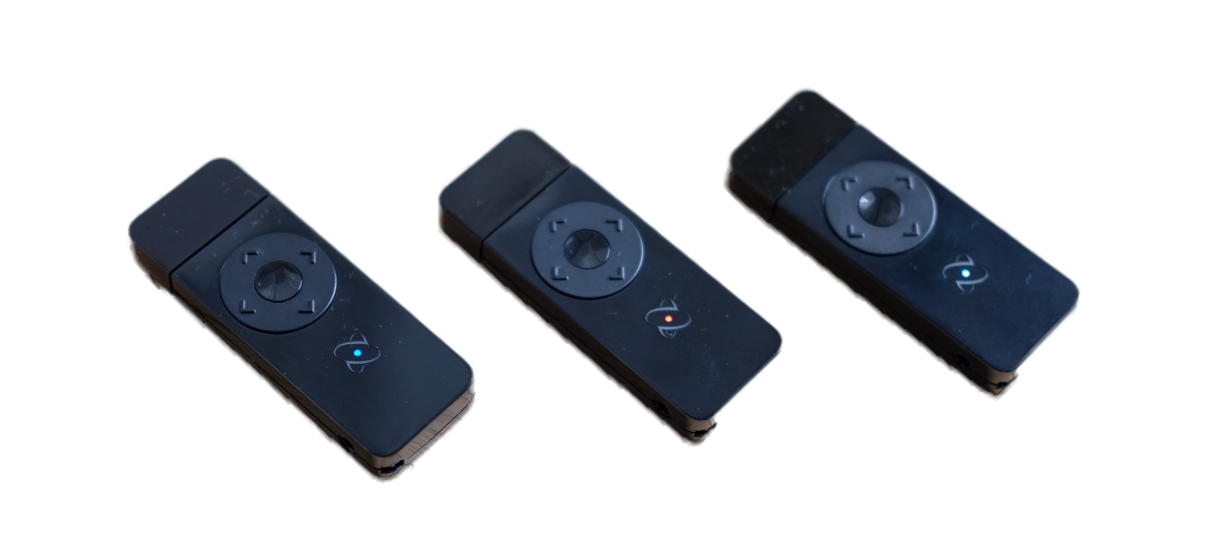
Get to Know the Swivl Markers

Slide 18
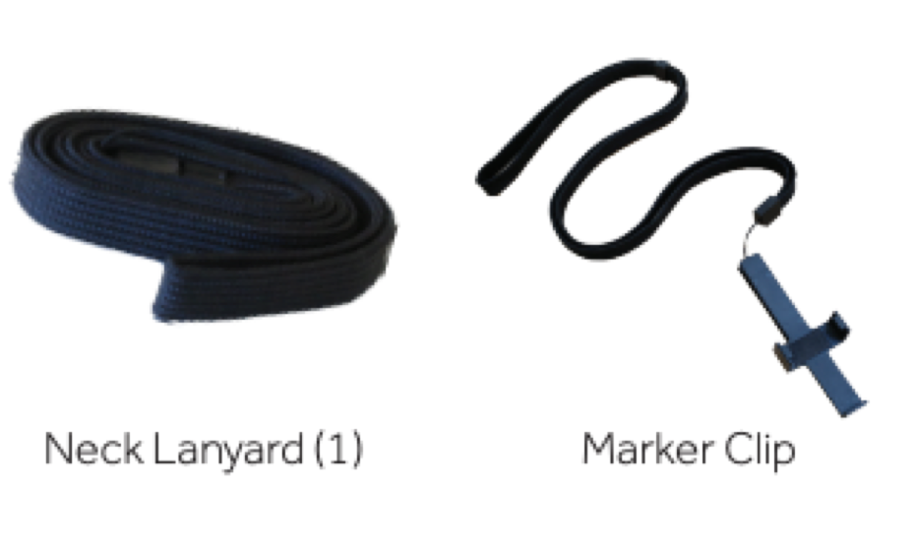
Markers: CX
Primary Marker
Teacher wears Primary
Secondary Markers
Place around classroom to capture student audio

Slide 19
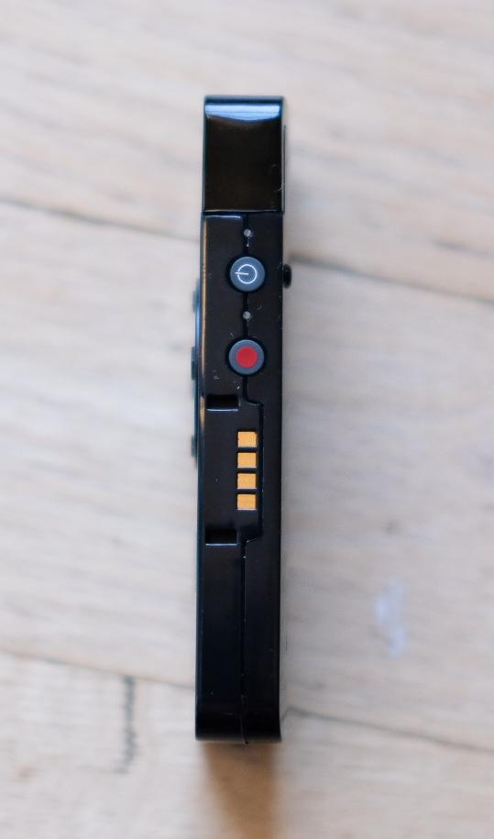
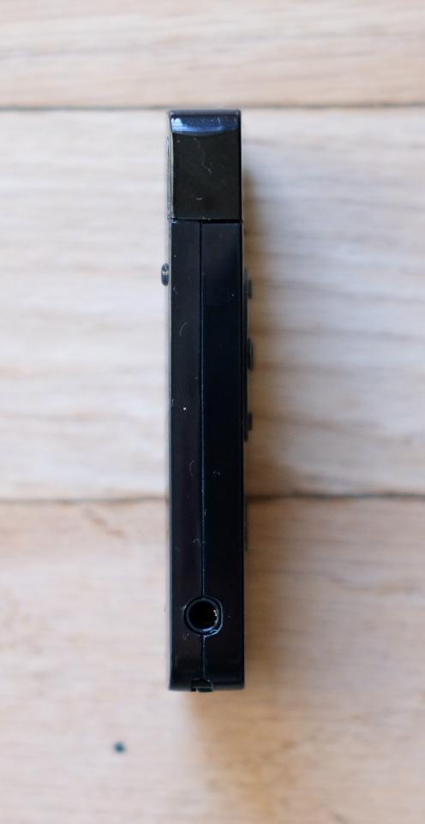
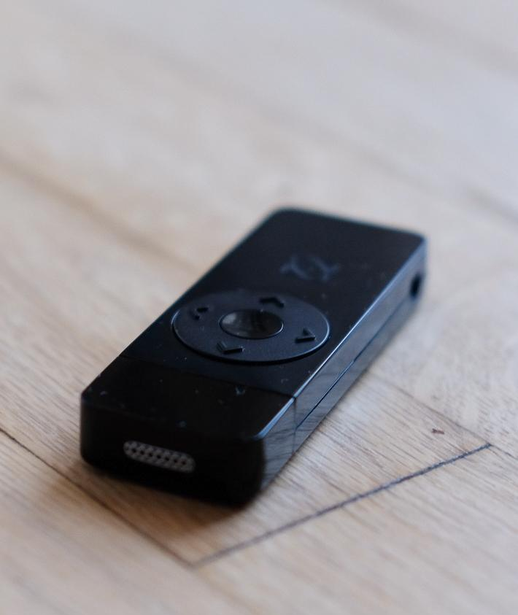
Marker Features: CX
LED Light: denotes whether marker is primary (white) or secondary (other colors).
Audio Jack (using earbuds)
&
Charging Port (using Hammerhead cable)
Microphone
Power
Record Start/Stop
Center: Pause/Resume robot tracking
Up/Down: Bookmarking (Pro feature)
Left/Right: Navigate slides (rarely used)
Charging
Connectors
(used for charging in the Swivl base)

Slide 20
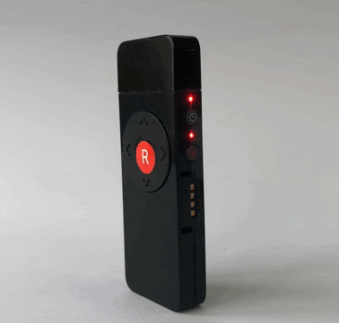
Marker LEDs
2 red flashing lights indicate either low battery or Swivl base needs a firmware update.
Markers and Base device updates:
Markers will only update when placed in the base and the iPad “Capture” App is open.

Slide 21
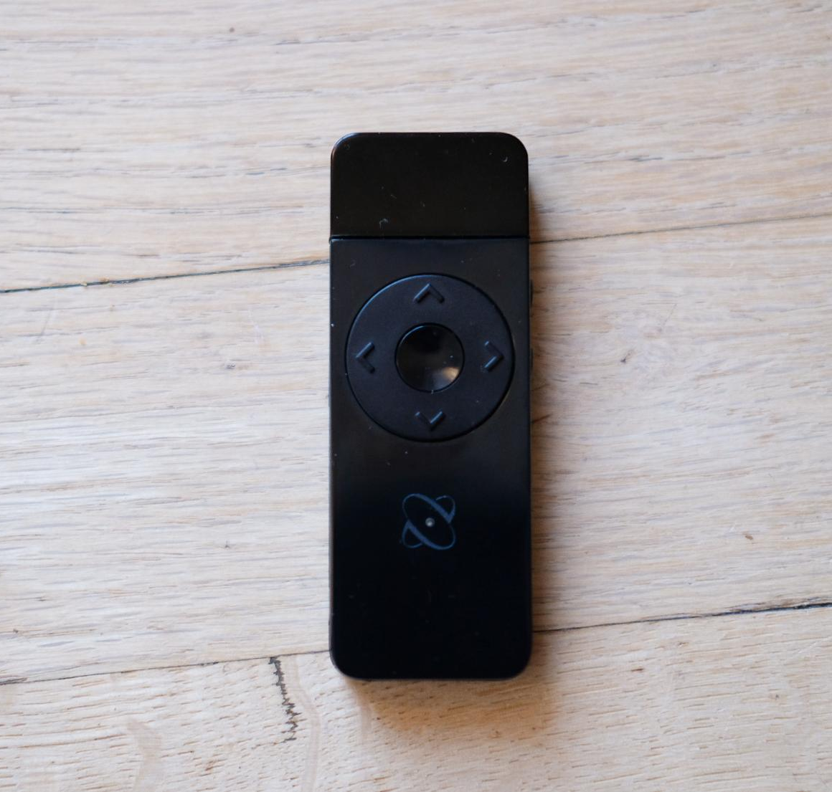
Marker Features: CX
Use the PRIMARY marker to pause and resume robot tracking.
Press the center button.
The LED light indicates whether the marker is primary (white) or secondary (blue, green, red, orange, or purple).
It will turn off after 15 seconds to save battery.

Slide 22
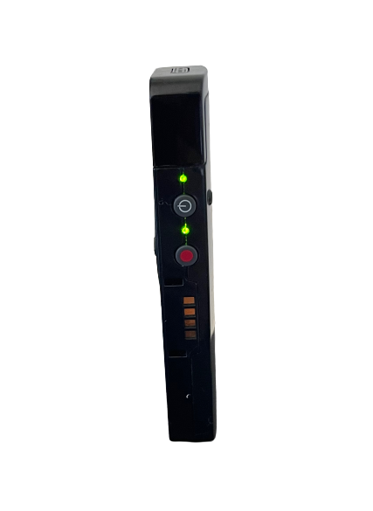
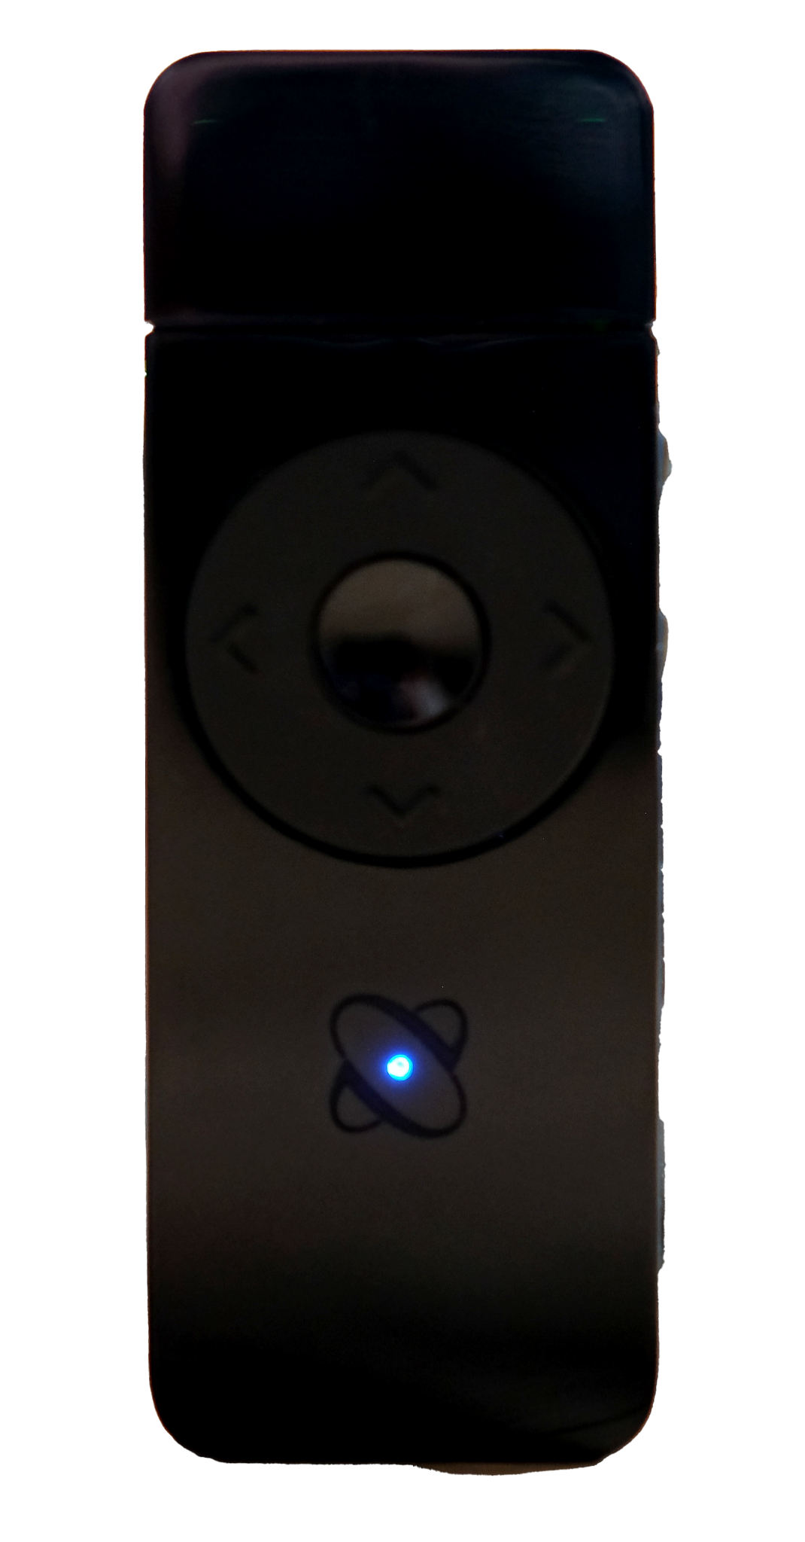
PRIMARY Marker: CX
**The Swivl base only tracks the PRIMARY Marker.
White LED light on front
Two green lights on side
Center button pauses/resumes robot tracking
Teacher microphone
Can mute secondary markers when live streaming

Slide 23
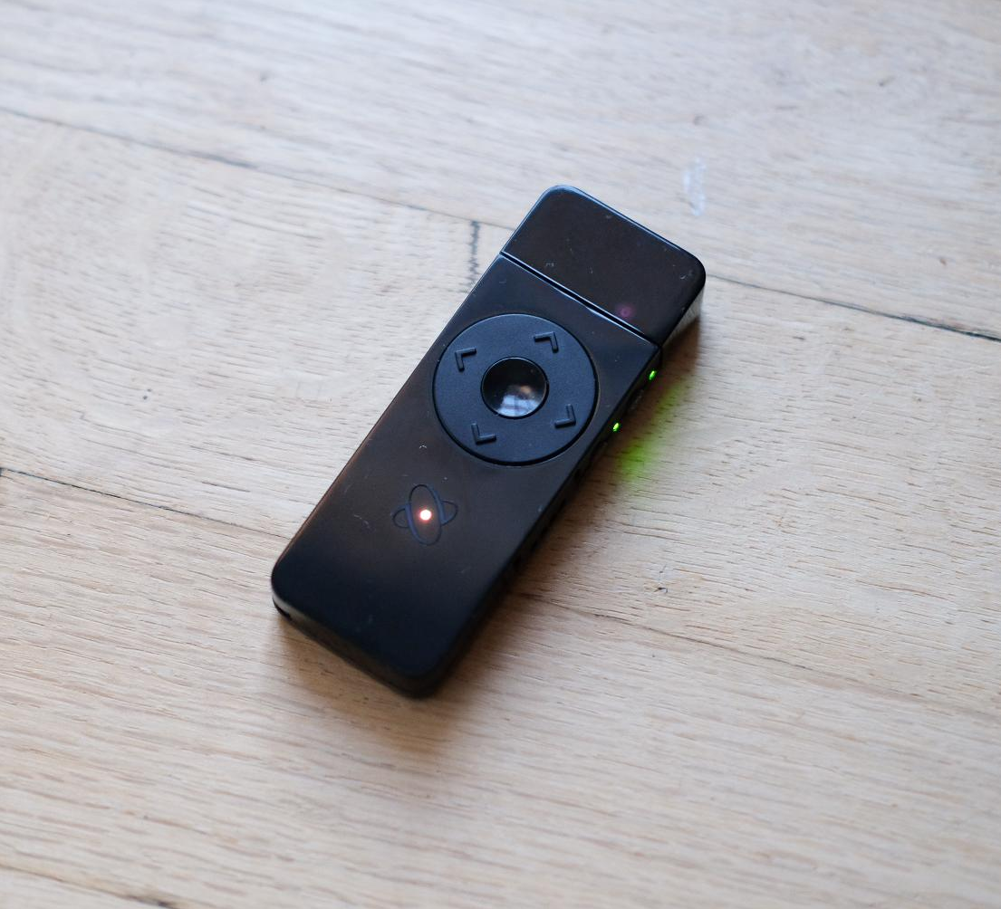
Bookmark during Recording
Quickly mark a point in the video to view later.
Marking a video makes it easy to find a specific point in a video without needing to view the complete video.
While recording, create a bookmark by pressing the up or down arrow on the Primary Marker.
***Swivl Reflectivity Feature*** -
This is included in our Swivl Reflectivity software.

Slide 24
Primary Marker Placement
Wear marker at heart height
Use in the provided lanyard or clip - not in your hand
Separate from other items around neck

Slide 25
Secondary Markers: CX
CX SECONDARY Markers
Collects audio in the classroom
Indicated by 1 side green light and a colored front LED light
Are not tracked by robot
Enable audio tracks to be heard individually during playback on Swivl Teams (video software)
Control microphone gain from within the Swivl app settings.

Slide 26
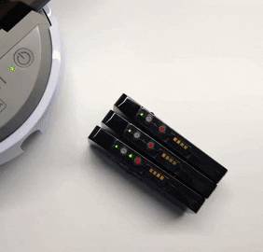
Marker Muting
While live streaming, you can mute the Primary and Secondary markers at once.
Firmly double-click the red button on your Primary marker.
All markers will be muted.
Markers will flash green while in mute mode.
TO UNMUTE: Firmly double-click the red button on your Primary marker.

Slide 27
Unpack, set up, and charge your robot and markers (and iPad ☺) Once everything is charged, mount the robot to the Swivl stand and place the iPad in the robot. Turn on the robot, the iPad, and a couple of the markers. Open the Swivl App on the iPad using your Swivl account information (teachers account).

