Slide 1

Dental Insurance
Delta Dental of MN

Slide 2

Dental Plan Overview
Insurance carrier: Delta Dental of MN
Network:
  PPO vs. Premier – What’s the difference?
    The Delta Dental PPO network is a smaller, more narrow network with larger provider discounts available
    The Premier network is the largest nationwide network
  Helpful tip: Seeing a provider in the PPO network will give you the largest provider discounts and you will likely pass less out of pocket for your services.
How to find an in-network provider:
  Step 1 – Follow the link: www.deltadentalmn.org
  Step 2 – Click on “Find A Dentist”
Helpful tip:
Always get a pre-treatment estimate before receiving major services so you know what costs you are responsible for, and what the insurance company will pay.

Slide 3
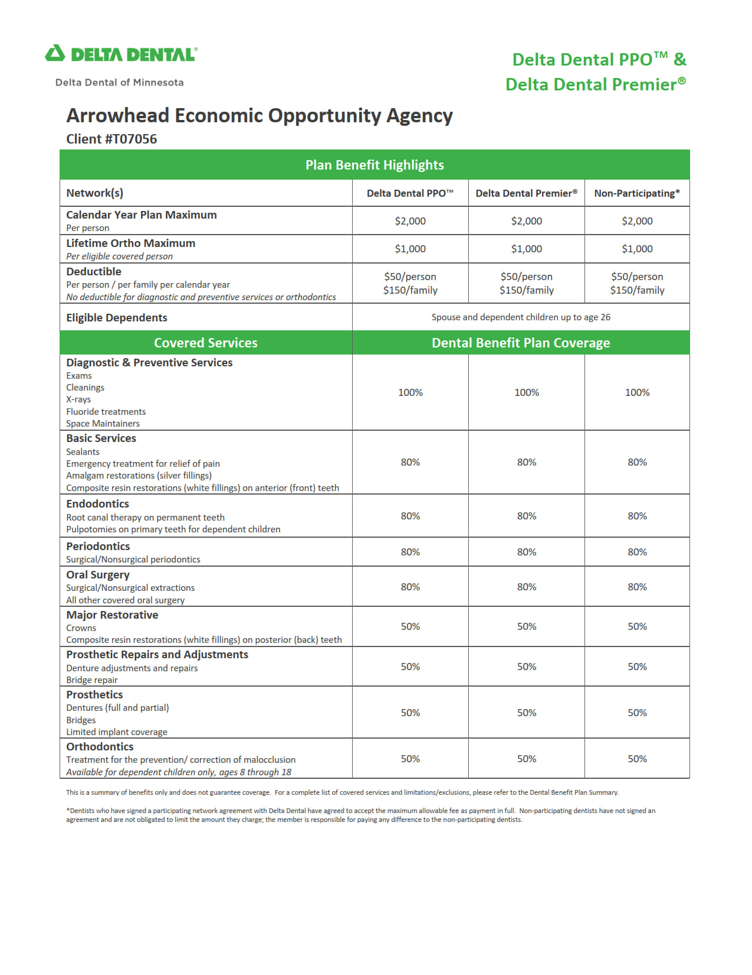

Slide 4
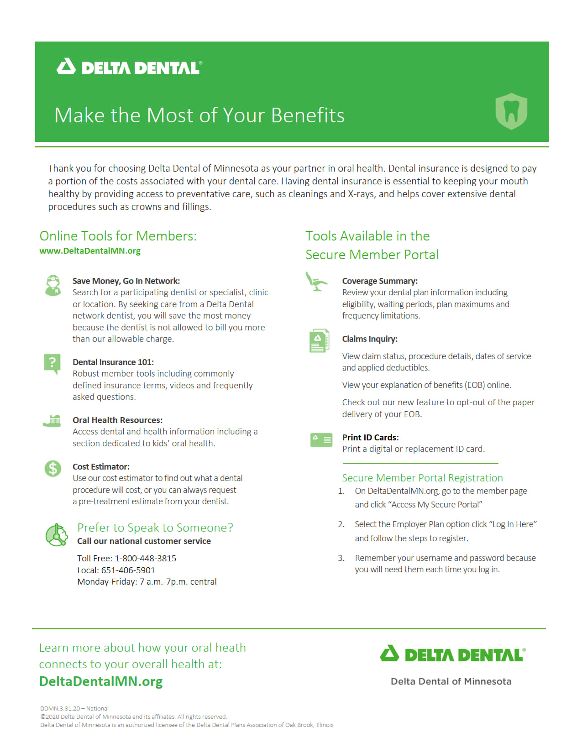

Slide 5
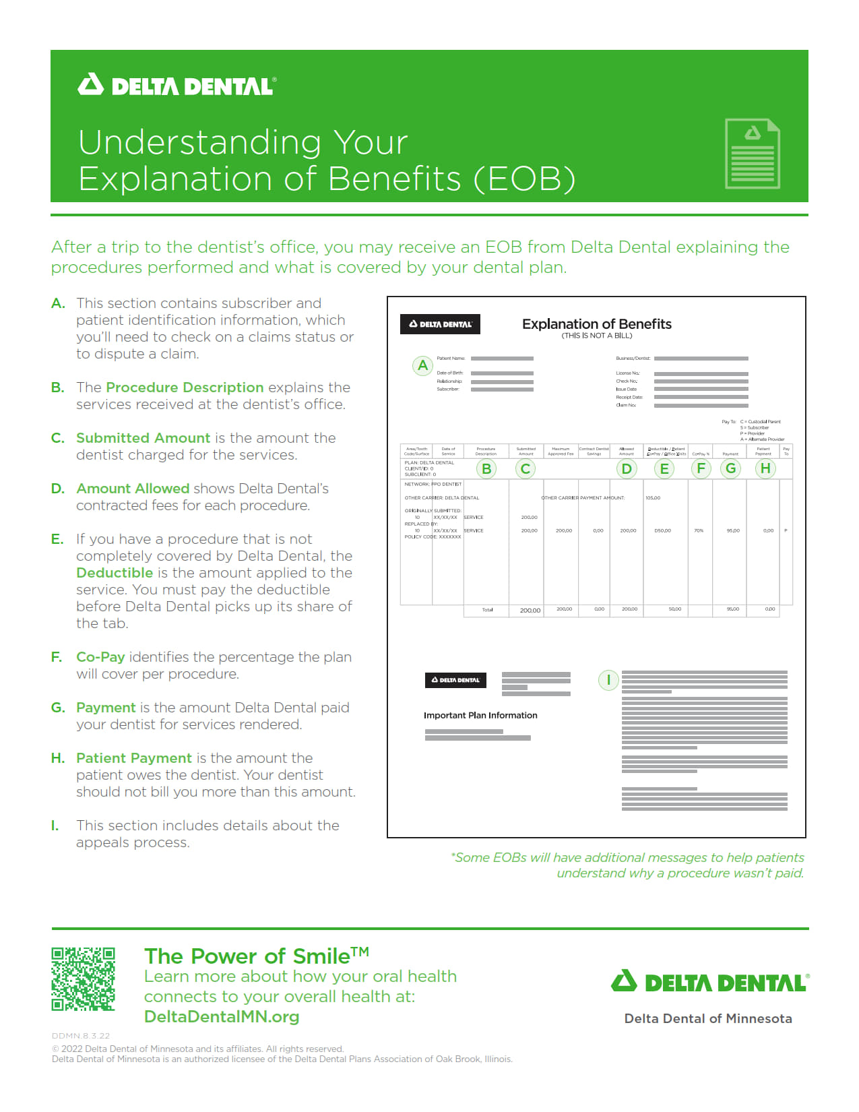

Slide 6
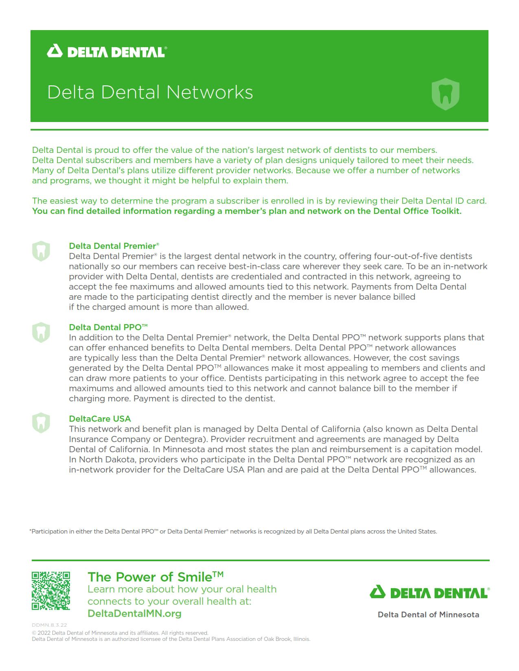

Slide 7
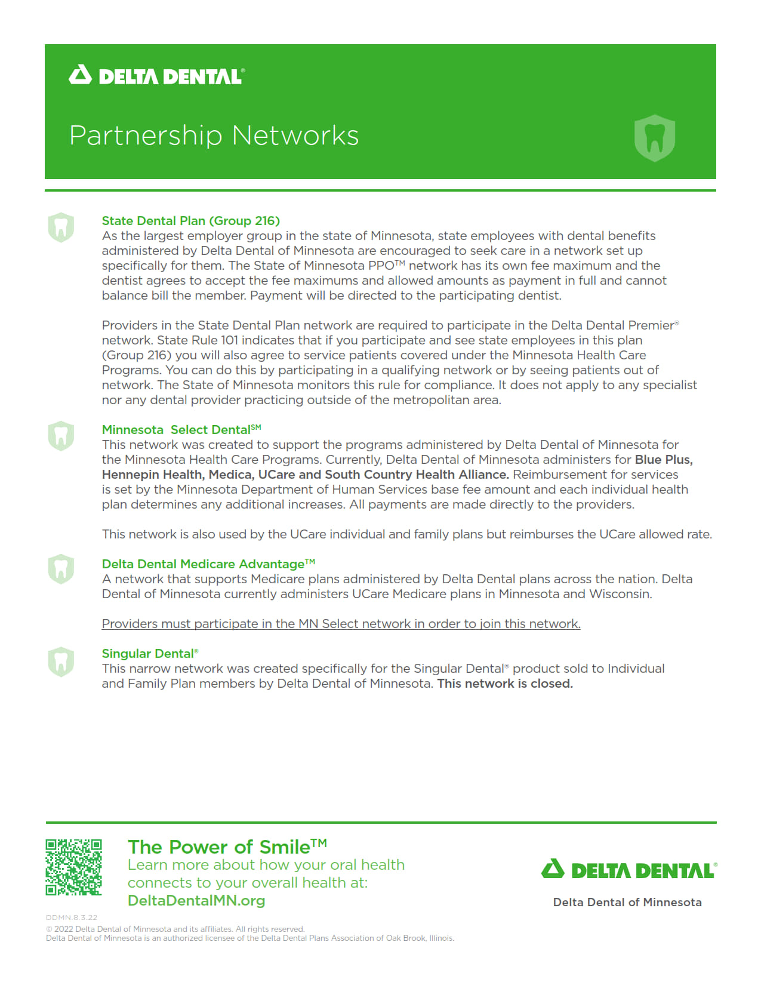

Slide 8
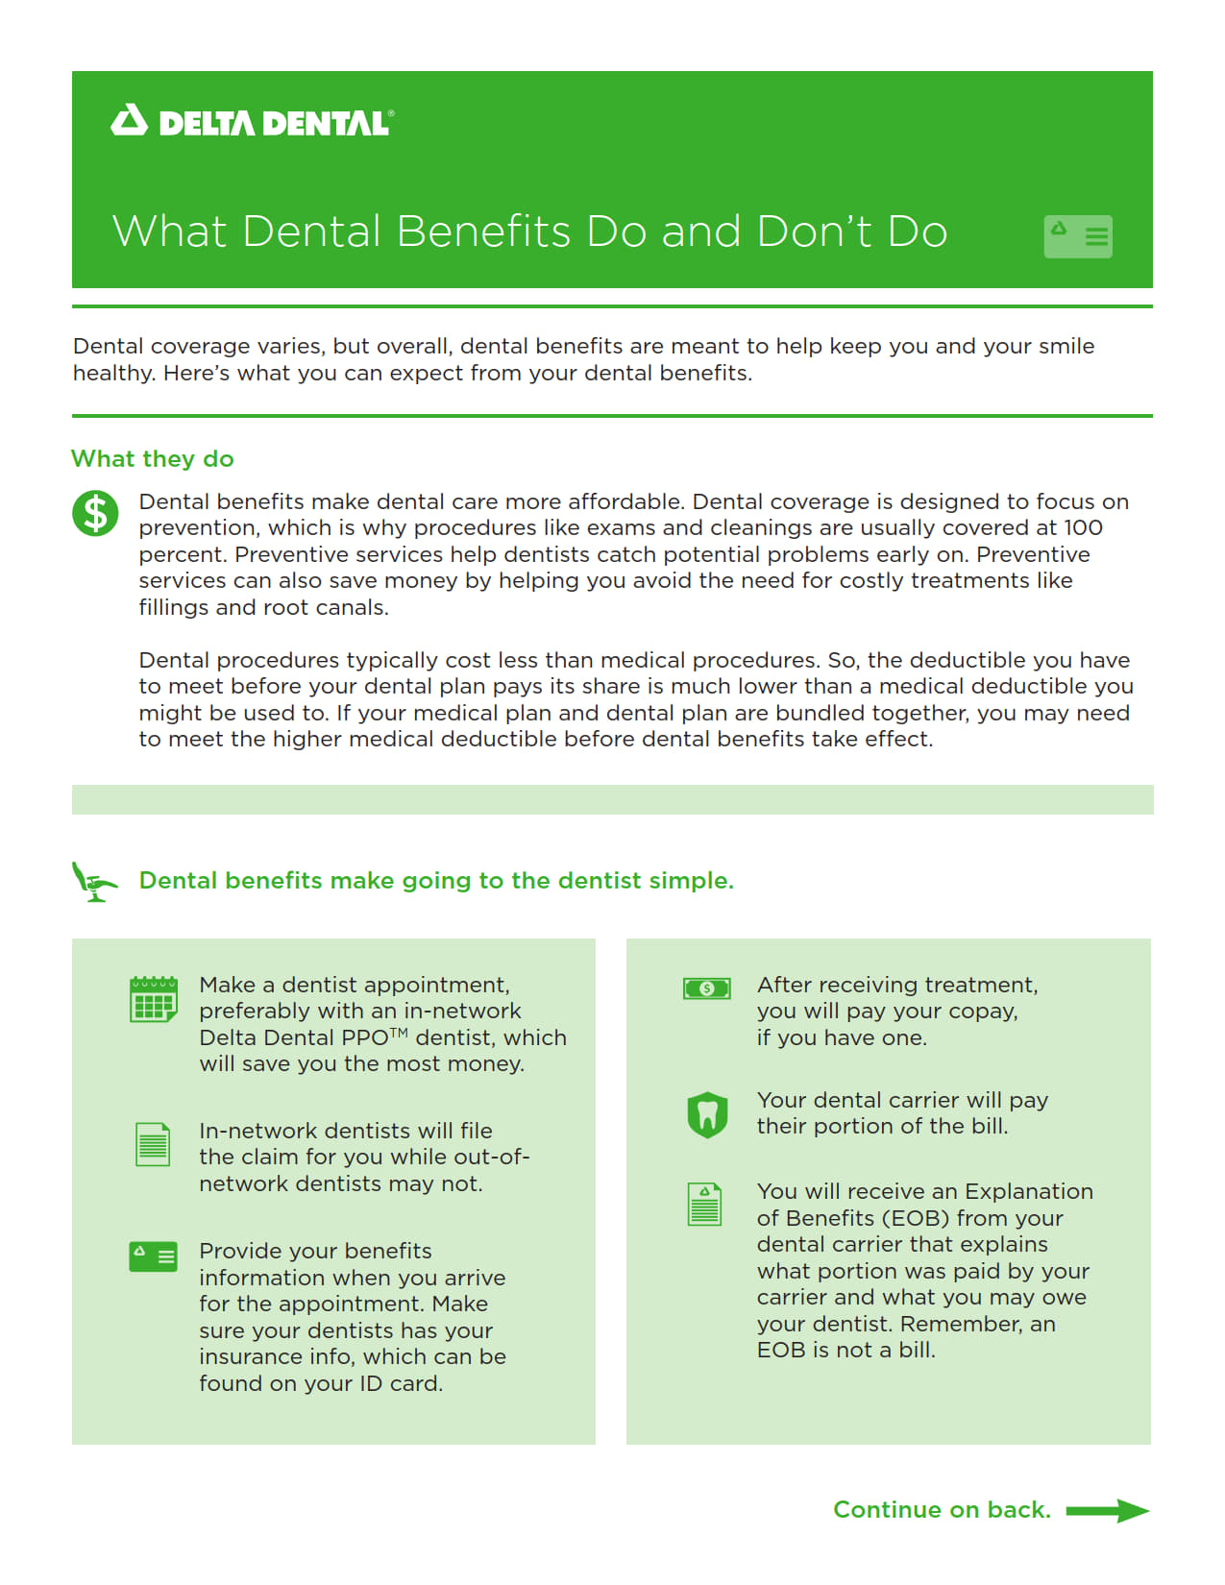

Slide 9
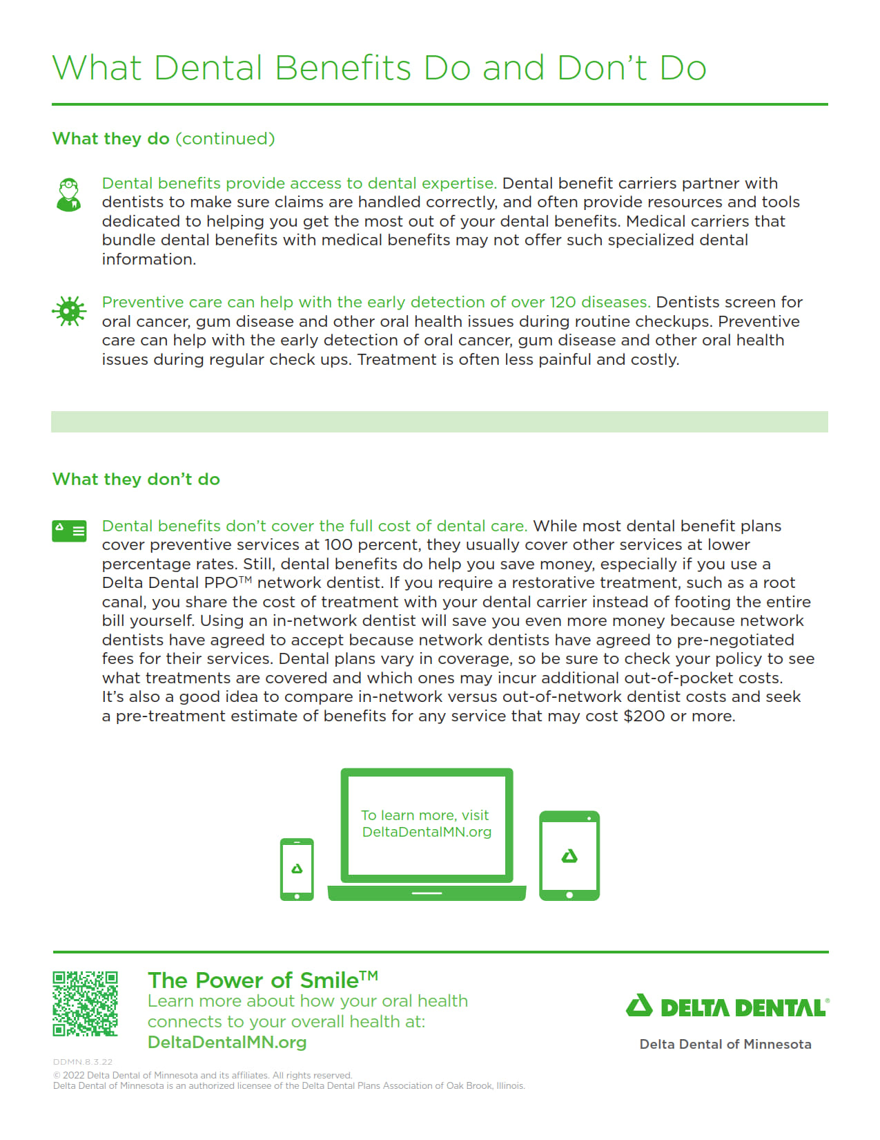

Slide 10
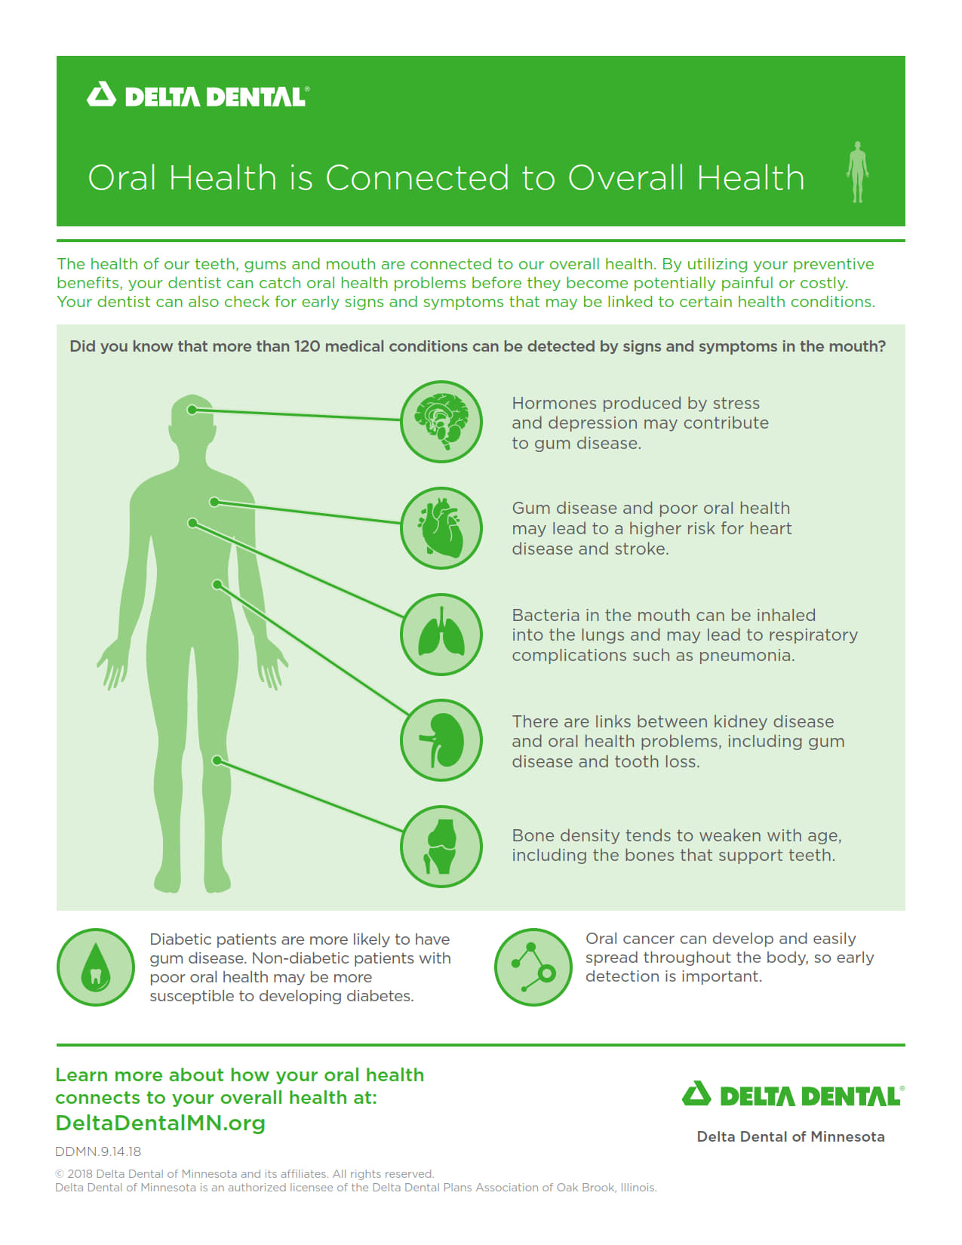

Slide 11

Questions?
Contact Human Resources

